Slide 1

REST Web API using .Net 5
Viswanatha Swamy
LinkedIn: https://www.linkedin.com/in/viswanatha-swamy-b57326128/
Twitter: https://twitter.com/vishipayyallore
Dot Net Learners House

Slide 2
Information
I am still a learner. Apologize if I do any mistake.
All the sessions will be hands on.
Will have parking lots for queries and other topics.
Some of the concepts we will be introduced and revisited in next sessions.
There are multiple ways to do, we will use one of the ways.
The focus was more on concepts and demos are kept simple.
Dot Net Learners House

Slide 3
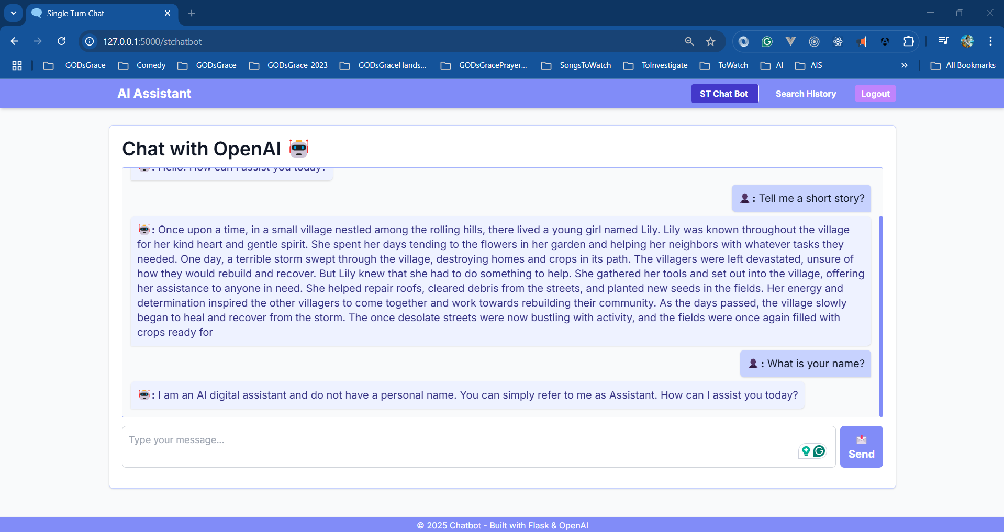

Slide 4
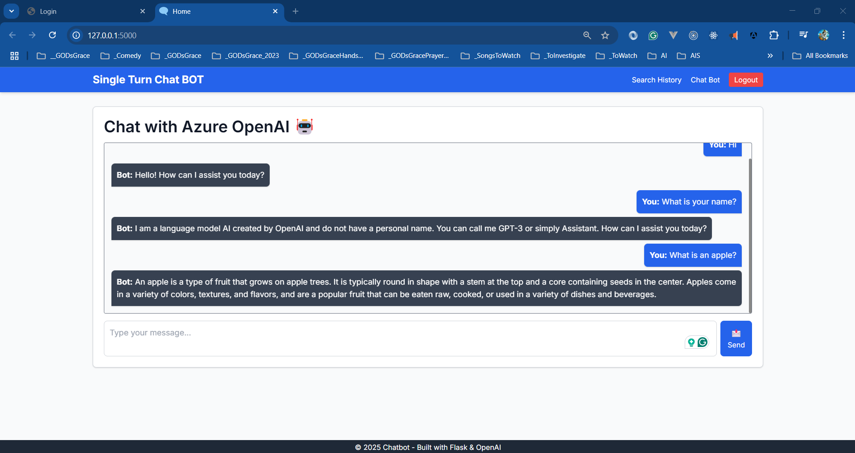

Slide 5
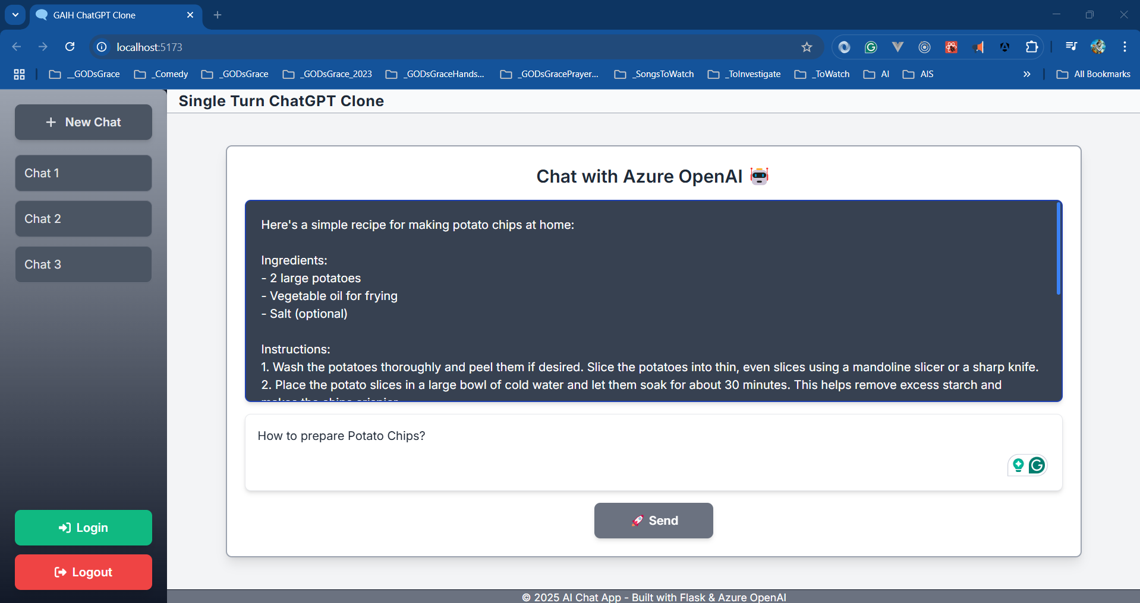

Slide 6
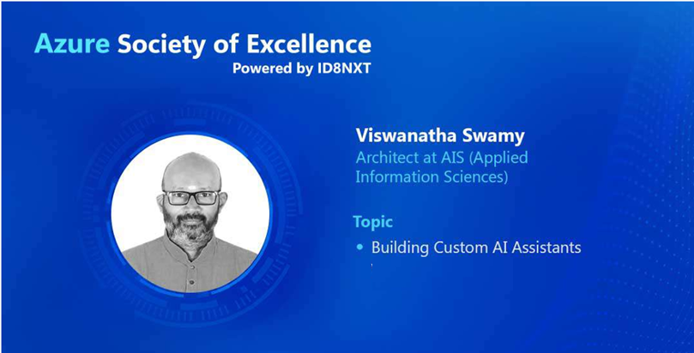

Slide 7

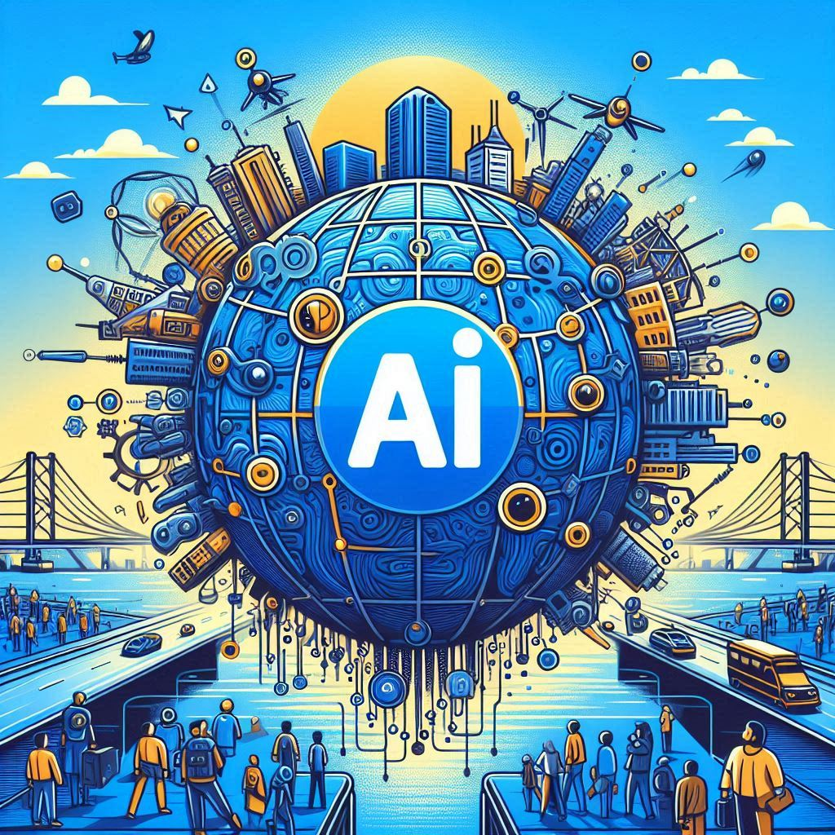
Global
Hyderabad

Slide 8
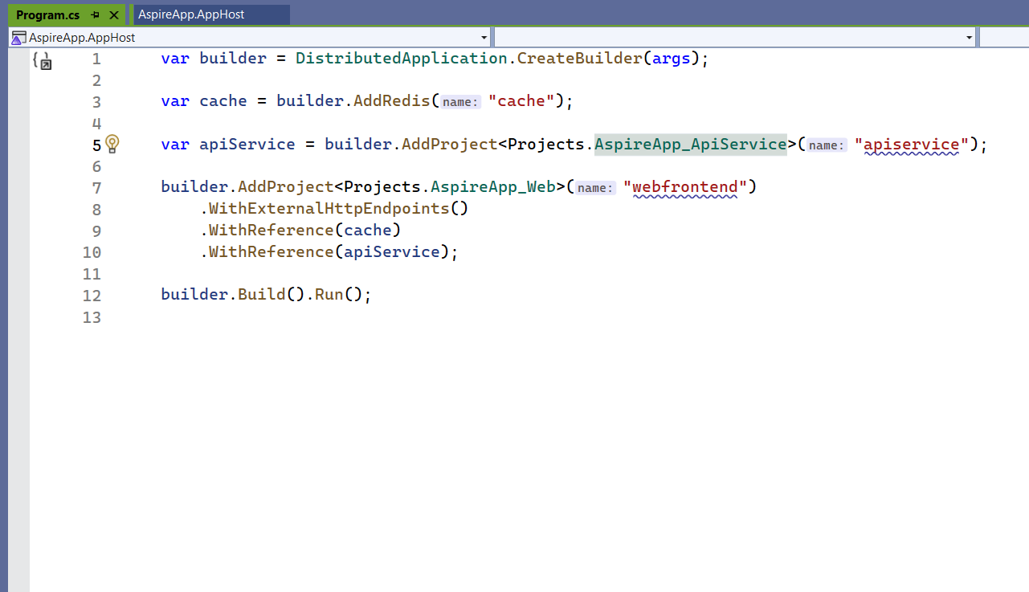
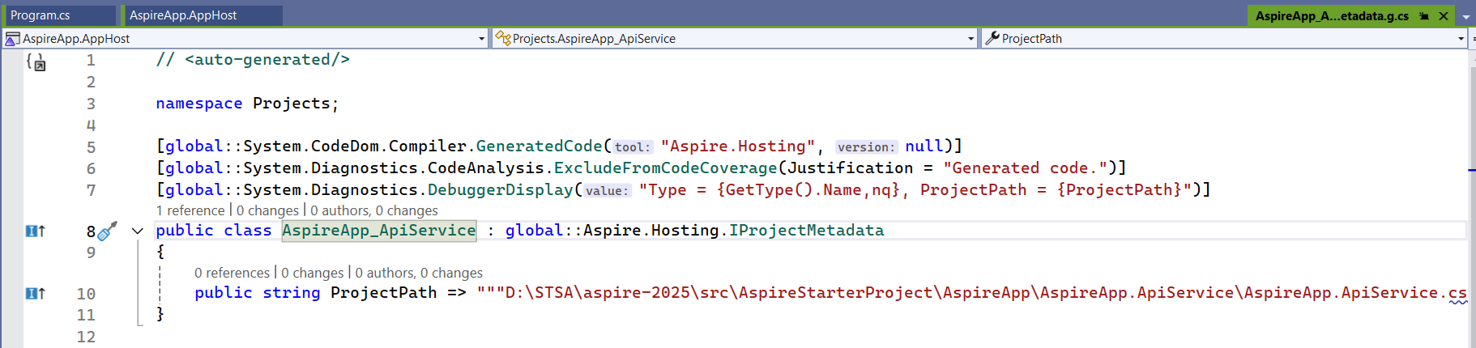

Slide 9
Please fasten
your
seat belt !!!
Dot Net Learners House

Slide 10
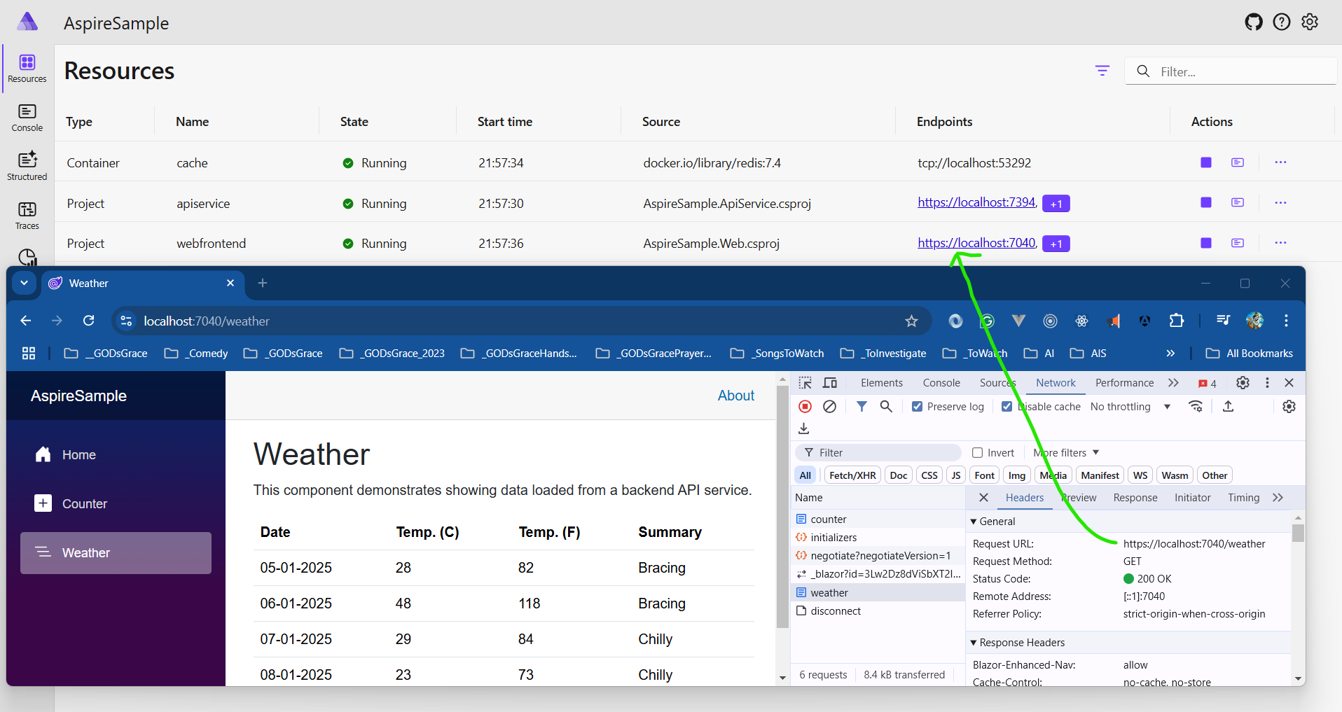

Slide 11
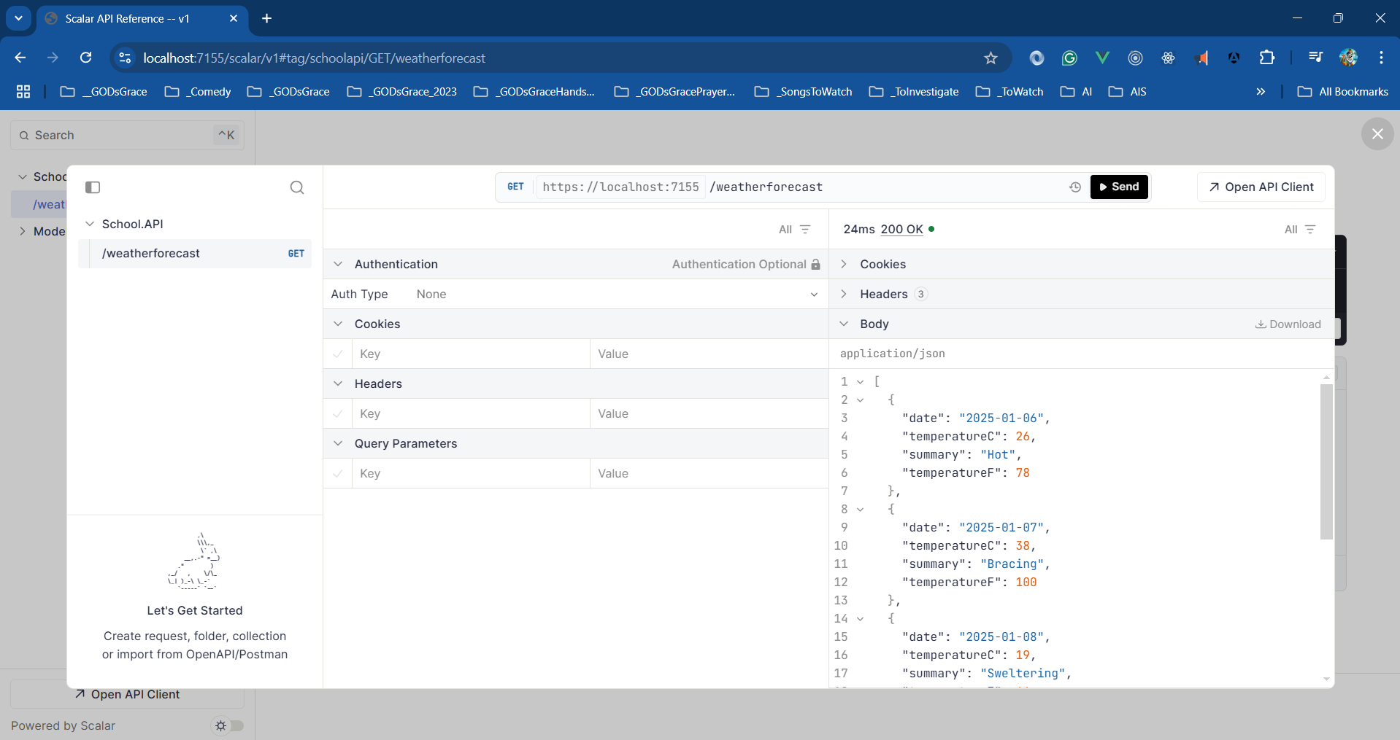

Slide 12
Information
I am still a learner. Apologize if I do any mistake.
All the sessions will be hands on.
Will have parking lots for queries and other topics.
Some of the concepts we will be introduced and revisited in next sessions.
There are multiple ways to do, we will use one of the ways.
The focus was more on concepts and demos are kept simple.
Dot Net Learners House

Slide 13
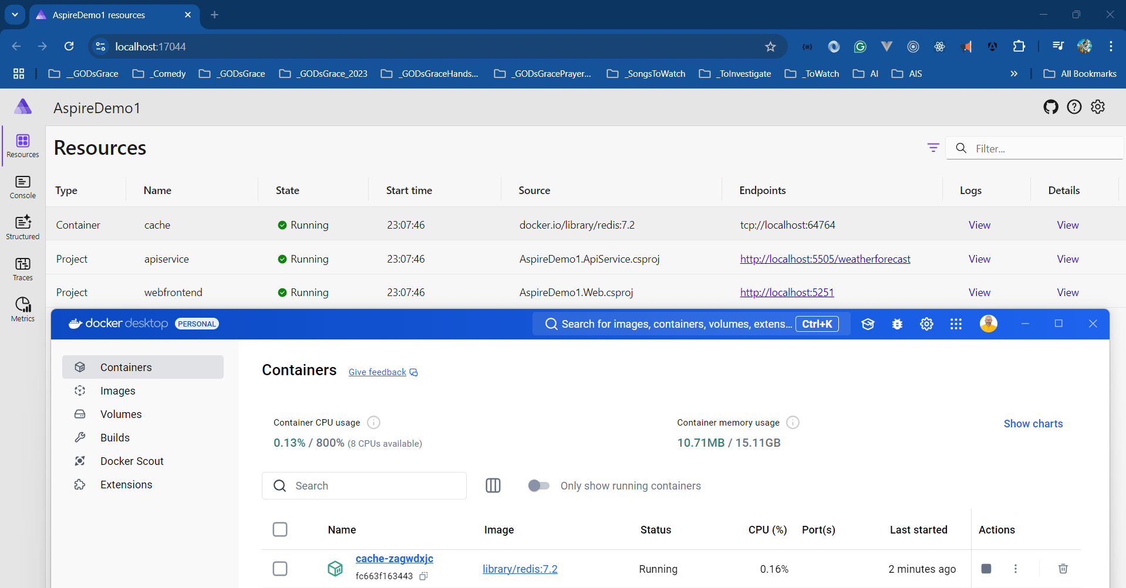

Slide 14
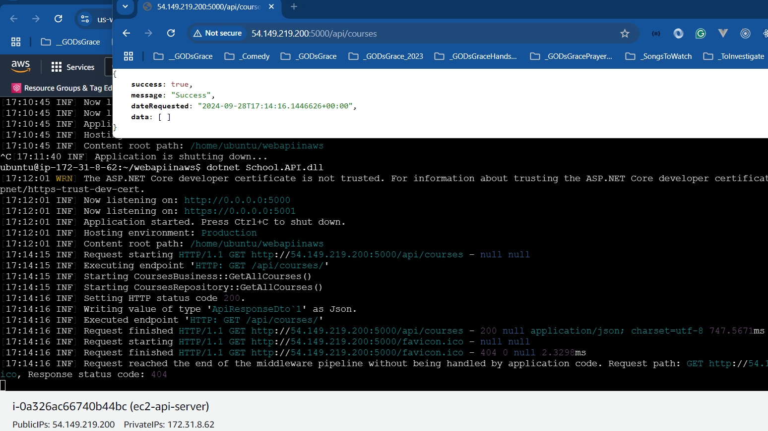

Slide 15
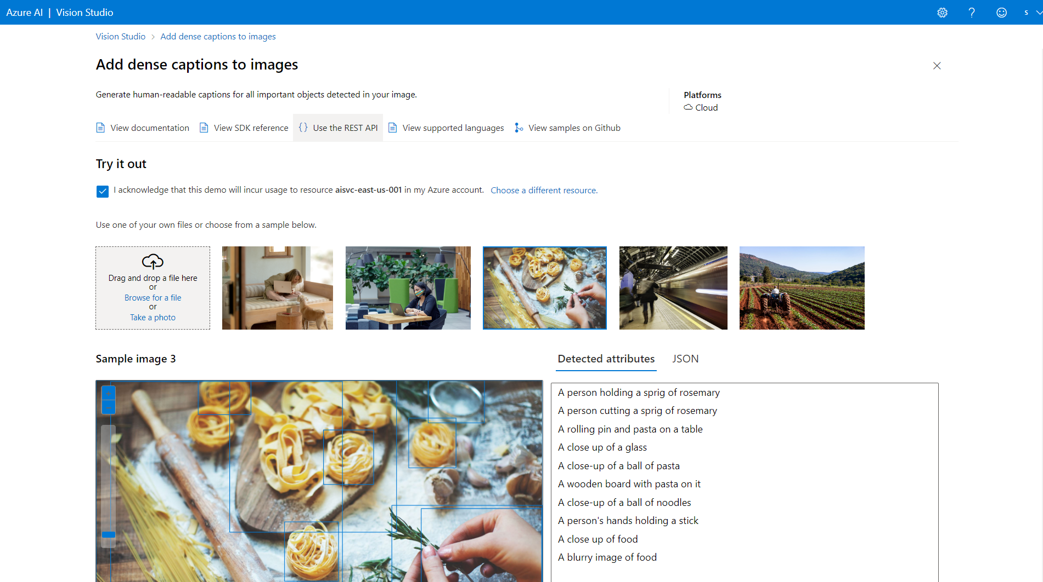

Slide 16
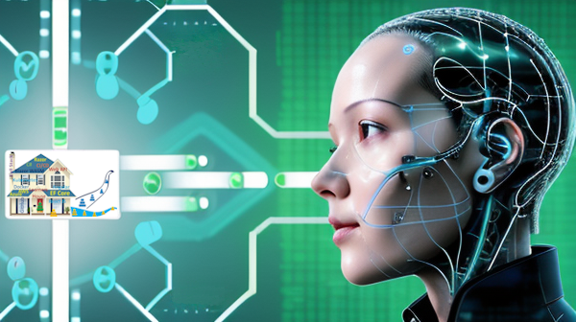

Slide 17
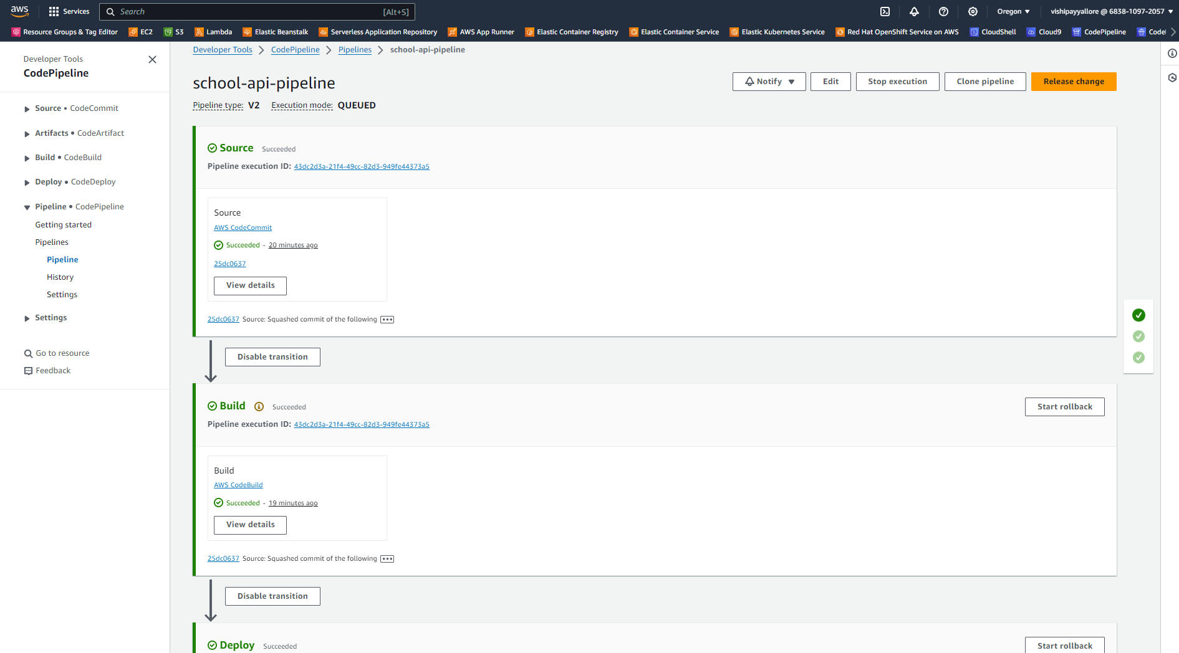

Slide 18




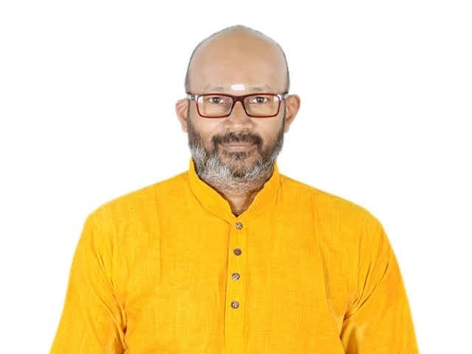
Dotnet Learners House
Series Introduction, and Getting started with Go
Thu, Apr 01, 2024
09:00 AM (IST)
Series Introduction, and Getting started with Go
Viswanatha Swamy
Architect - AIS
Event URL: https://bit.ly/3TwNRDo

Slide 19
Dotnet Learners House
AI 102 - Prepare, Create, and Consume Azure AI services
Thu, Mar 18, 2024
09:00 AM (IST)
AI 102 - Prepare, Create, and Consume Azure AI services
Viswanatha Swamy
Architect - AIS
Event URL: https://bit.ly/48Qes4d

Slide 20
Dotnet Learners House
MS SQL Server, Docker, Azure Data Studio, .NET 8, and EF Core
Thu, Feb 22, 2024
09:00 AM (IST)
MS SQL Server, Docker, Azure Data Studio, .NET 8, and EF Core
Viswanatha Swamy
Architect - AIS
Event URL: https://bit.ly/48mcYyl

Slide 21
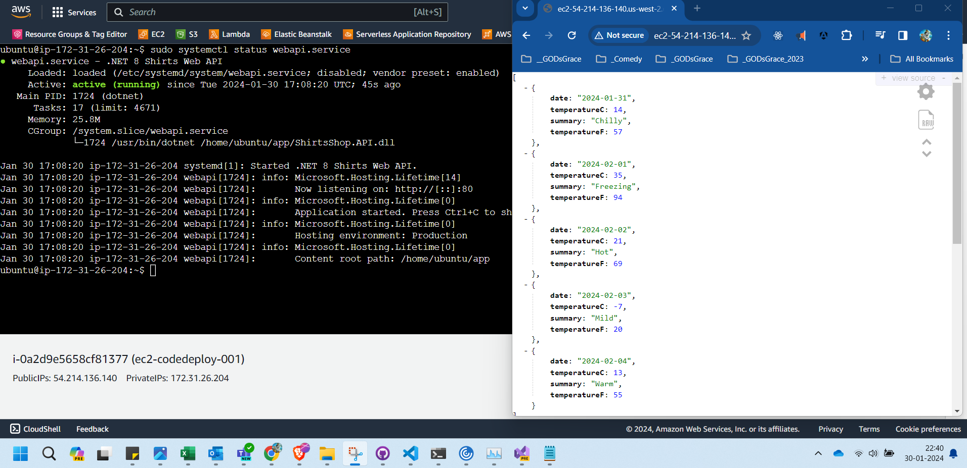
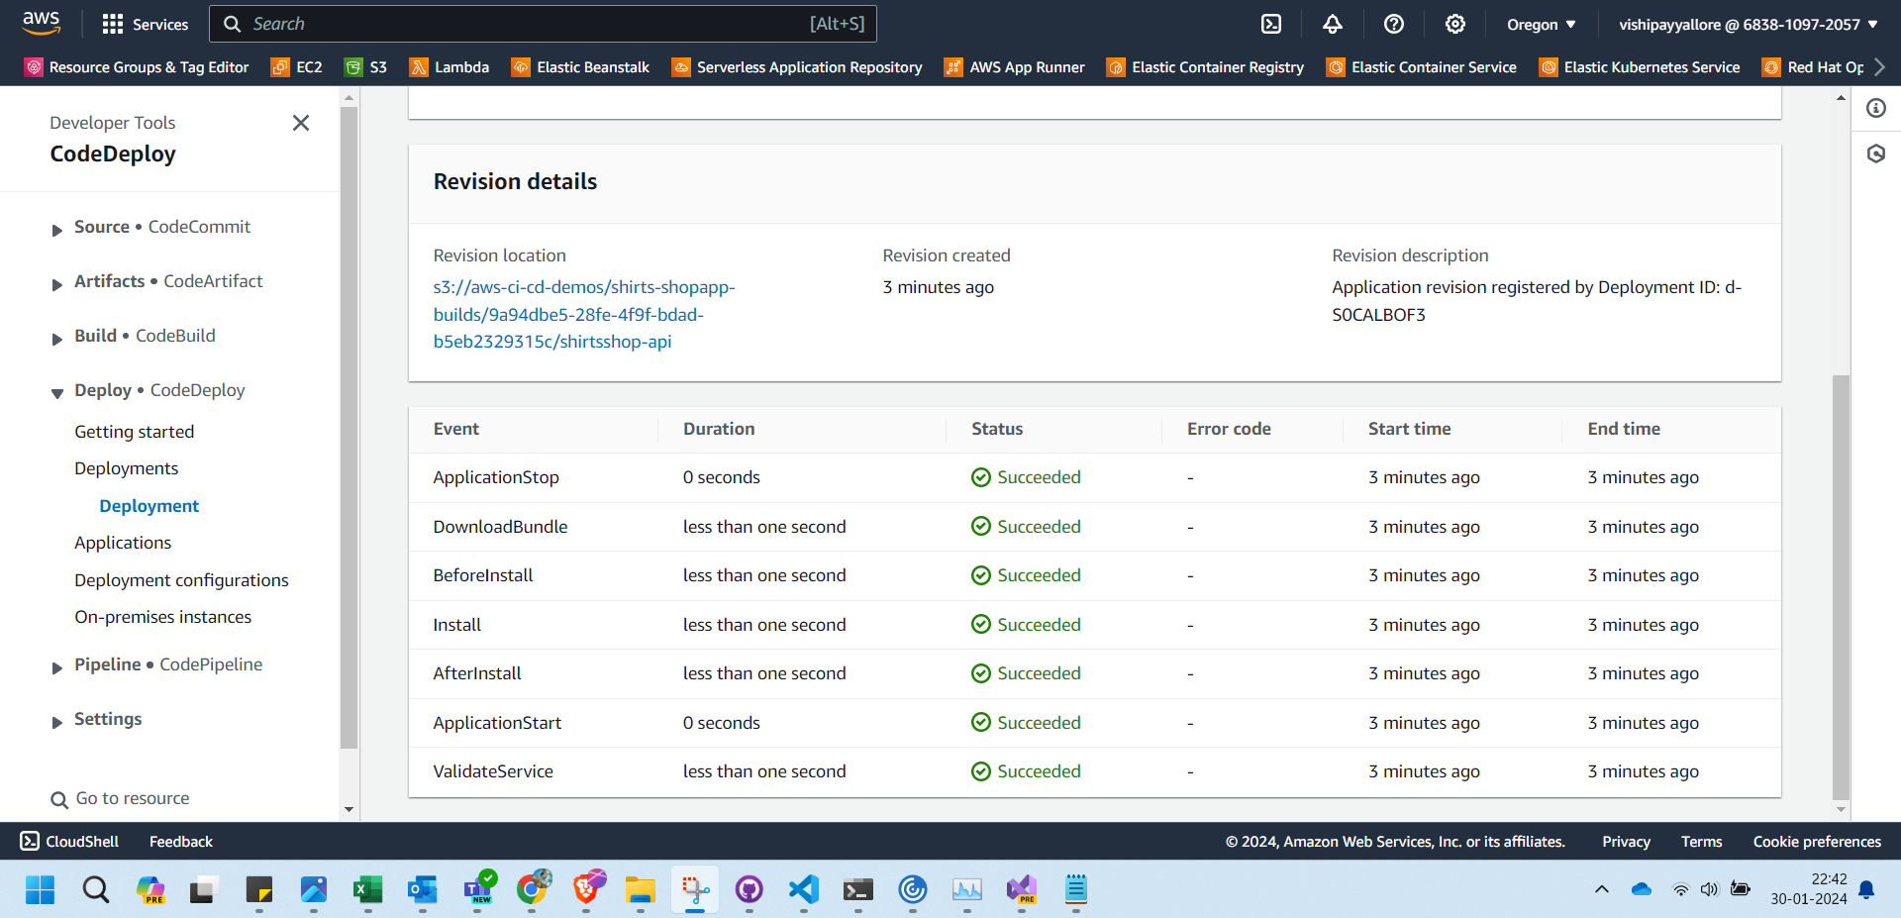

Slide 22





Reference Architecture
Client Apps
API Gateways / BFF
Identity Microservices
Event Bus (RabbitMQ / Kafka / Service Bus)
SQL Server
Mobile
React Native
Aggregator Web
Azure Open IA
Server Side
MVC
Razor
Blazor Server
Payment Microservices
Aggregator Mobile
Event Bus
SPA
Angular
ReactJS
Vue JS
Blazor WASM
Orders Microservices
MySQL
Discount Microservices
PostgreSQL
Basket Microservices
Admin Services
Redis
SPA
Admin UI
Health Check
Webhooks
Alerts / Monitoring
Products Microservices
Mongo

Slide 23


















Pull request, CI, and CD
Feature Branch
Code
Pull Request
Gated Build
Master Branch
CI Build
Artefacts drop
Environment A
Release

Slide 24
Dotnet Learners House
AWS - Code Commit, Build, Deploy with .NET 8 Minimal API
Mon, Feb 05, 2024
09:00 AM (IST)
AWS - Code Commit, Build, Deploy with .NET 8 Minimal API
Viswanatha Swamy
Architect - AIS
Event URL: https://bit.ly/4bdTSwY

Slide 25









Gimmicks Travels
3
2
4
5
1
6

Slide 26
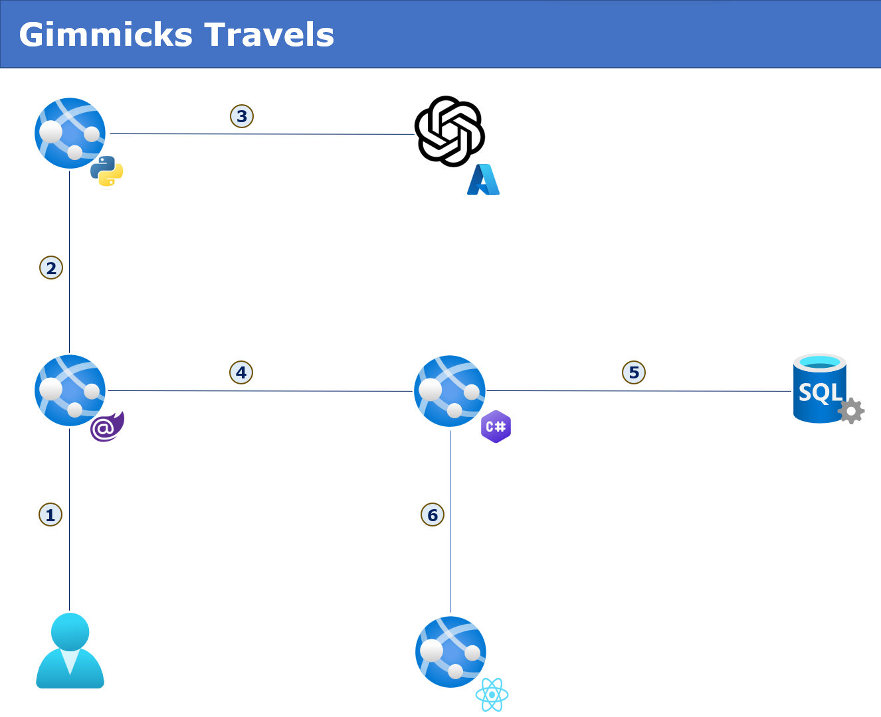

Slide 27
Dotnet Learners House
Microservices in .NET 8, and DAPR (Service to Service Invocation)
Mon, Jan 15, 2024
09:00 AM (IST)
Microservices in .NET 8, and DAPR (Service to Service Invocation)
Viswanatha Swamy
Architect - AIS
Event URL: https://bit.ly/3O1Gq5g

Slide 28
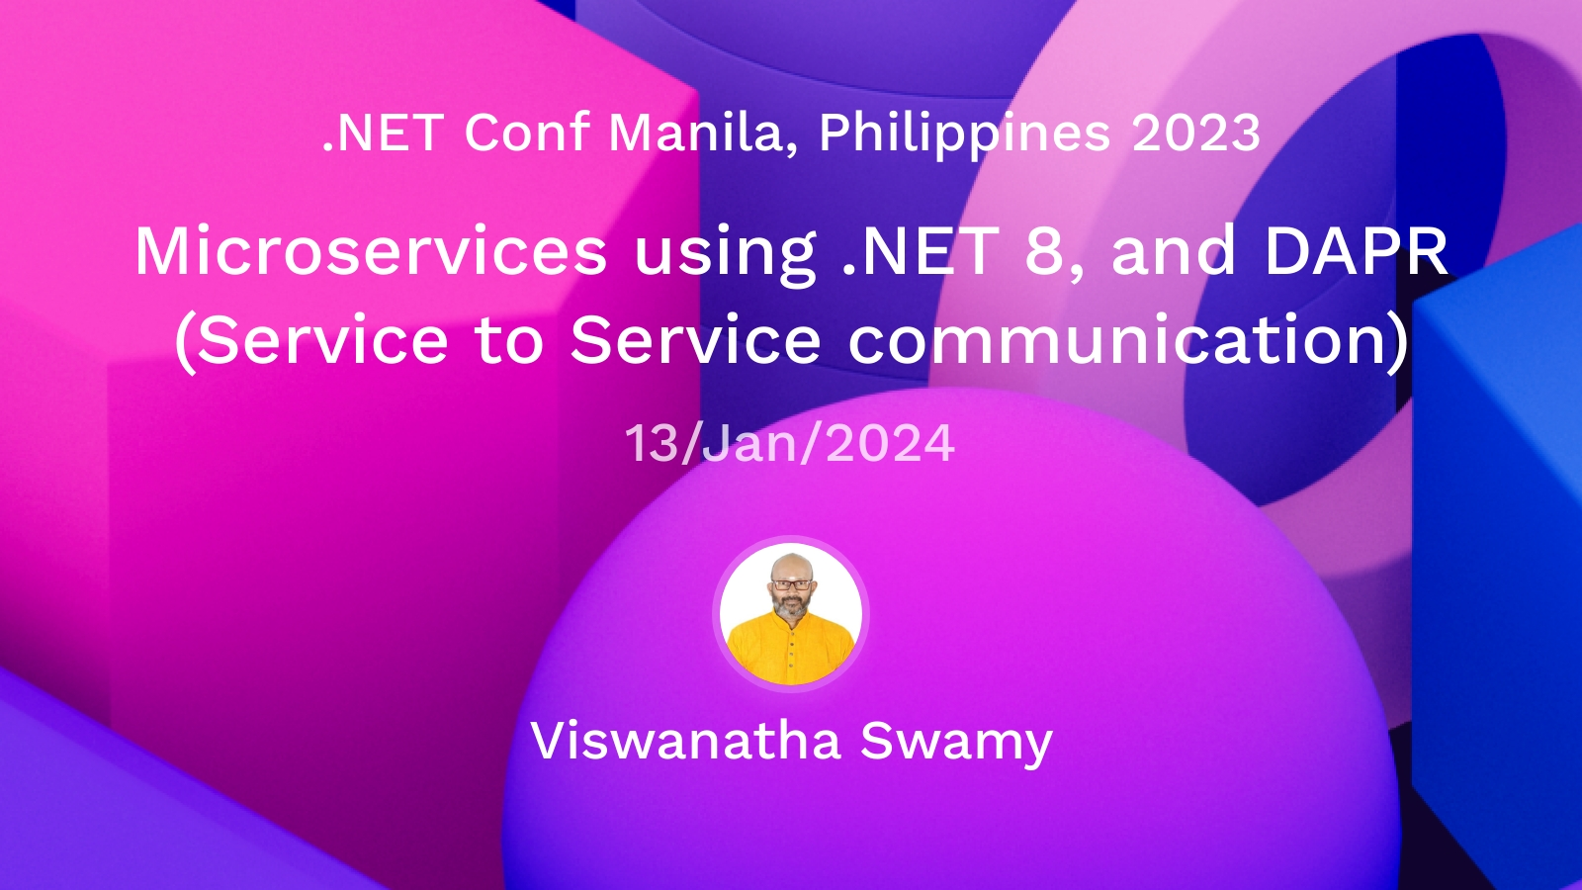

Slide 29
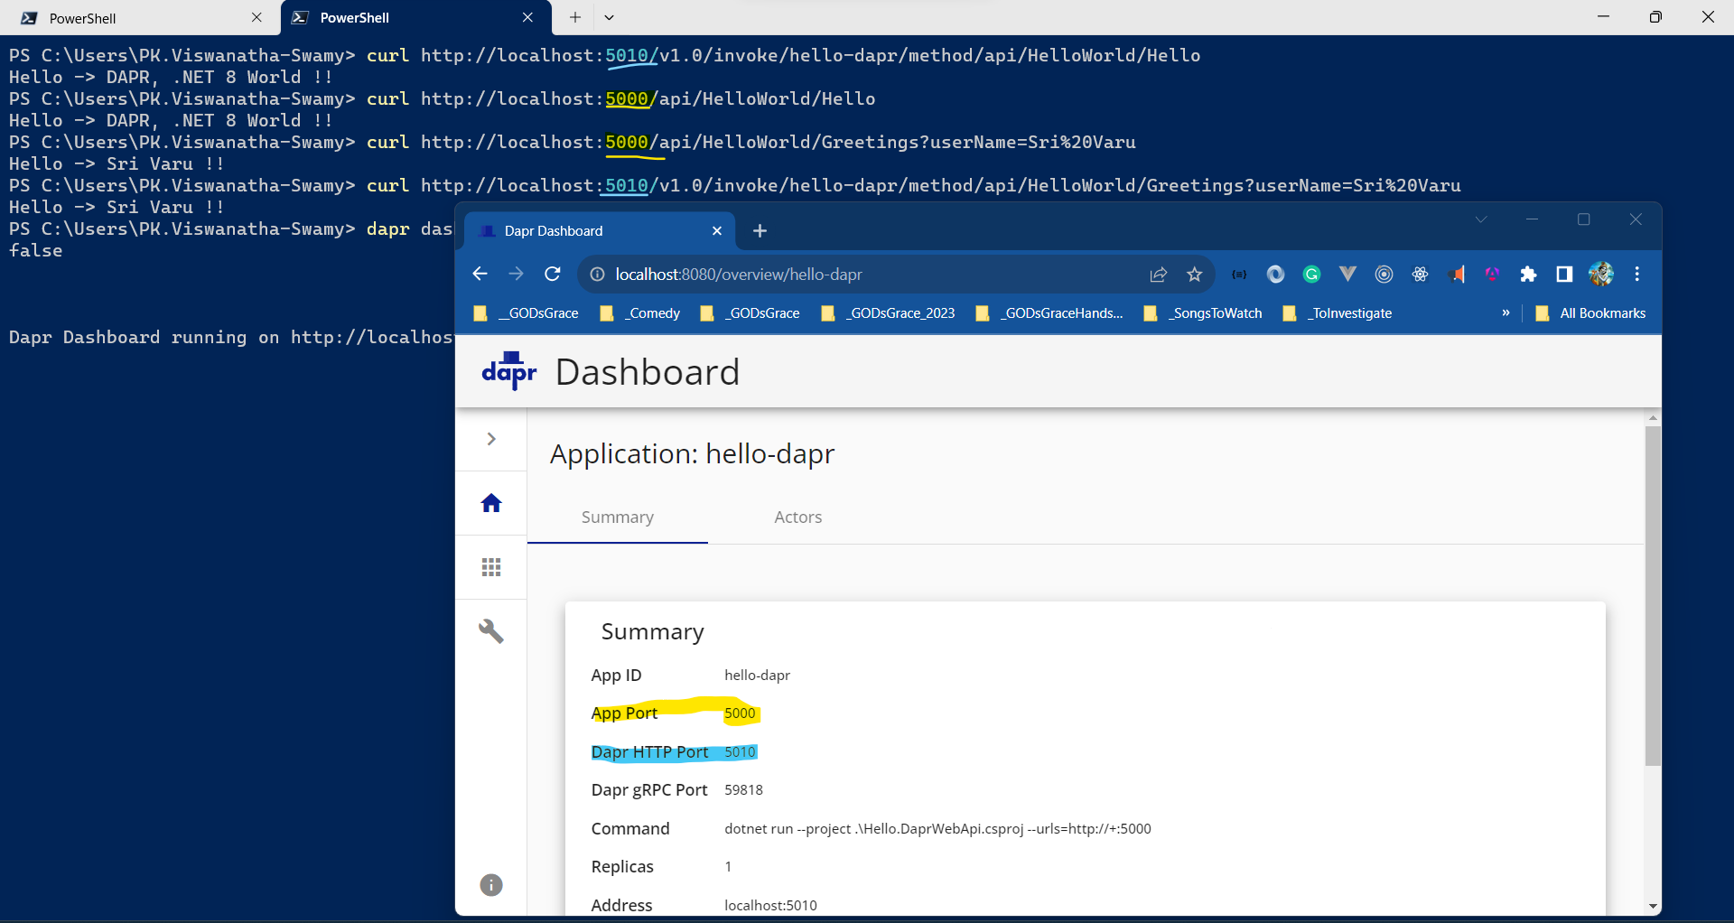

Slide 30
Dotnet Learners House
Dapr (Distributed Application Runtime), .NET 8, and VS Code
Mon, Nov 18, 2023
09:00 AM (IST)
Dapr (Distributed Application Runtime), .NET 8, and VS Code
Viswanatha Swamy
Architect - AIS
Event URL: https://bit.ly/3QHk2id

Slide 31
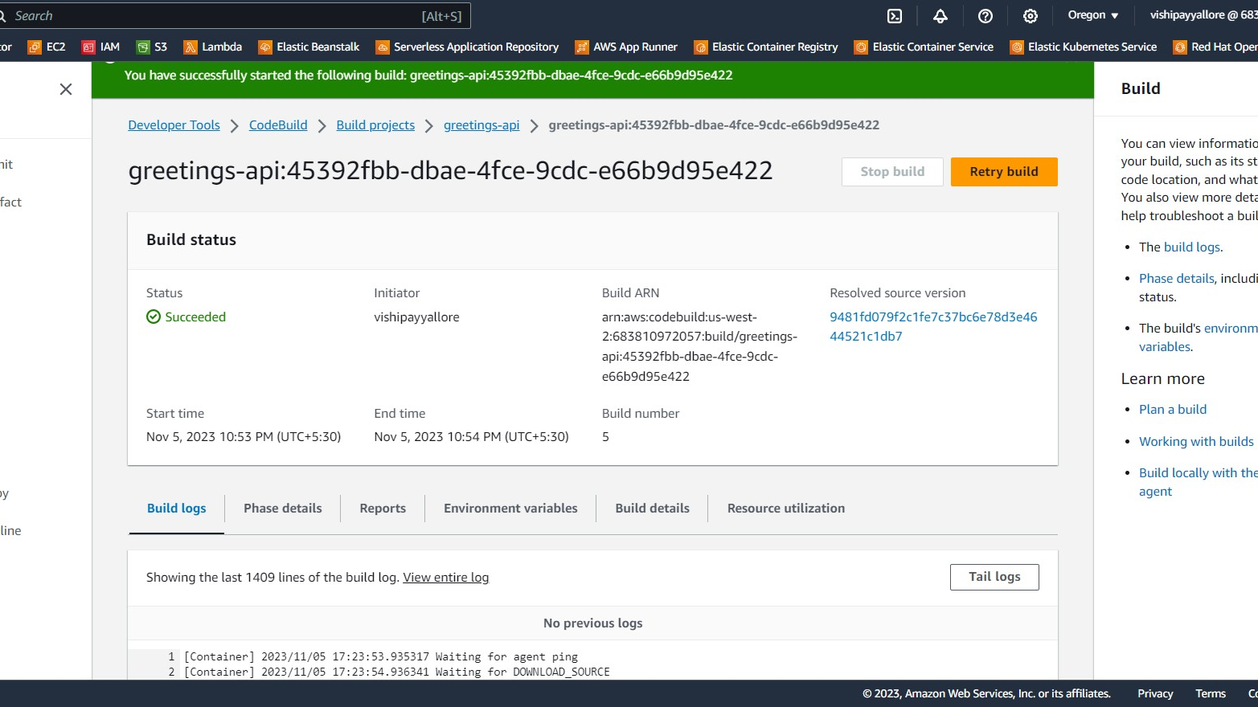

Slide 32
Dotnet Learners House
Hands-on with AWS - Code Build - .NET 8 / Java Spring Boot
Mon, Nov 06, 2023
09:00 AM (IST)
Hands-on with AWS - Code Build - .NET 8 / Java Spring Boot
Viswanatha Swamy
Architect - AIS
Event URL: https://bit.ly/3u49qlR

Slide 33
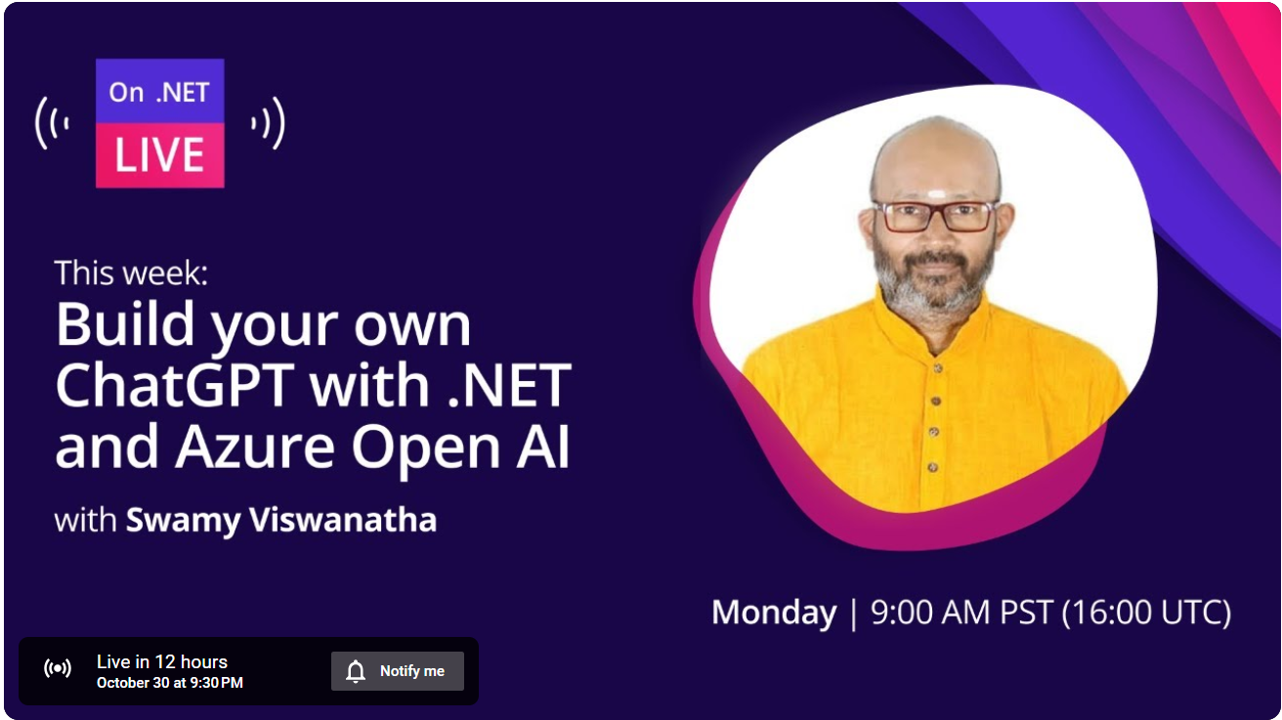

Slide 34
Travels
Py
AOAI
.NET 8
SQL
Blazor
Admin App
ReactJS / Nextjs

Slide 35
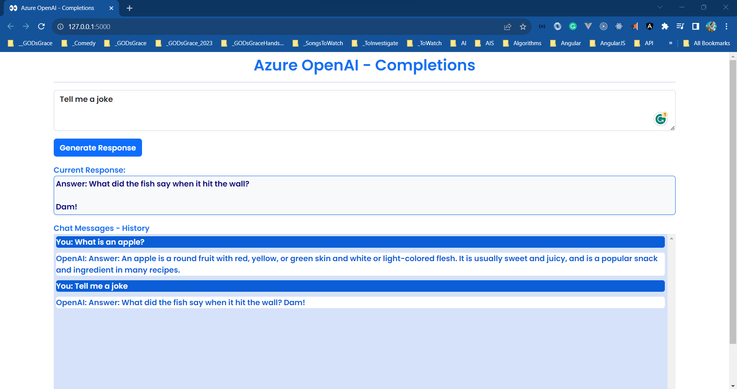

Slide 36
Dotnet Learners House
Chat GPT Clone - Flask, AOAI, HTML, JavaScript, Bootstrap 5.x
Sun, Oct 22, 2023
09:00 AM (IST)
Chat GPT Clone - Flask, AOAI, HTML, JavaScript, Bootstrap 5.x
Viswanatha Swamy
Architect - AIS
Event URL: https://bit.ly/3M7yRJm

Slide 37
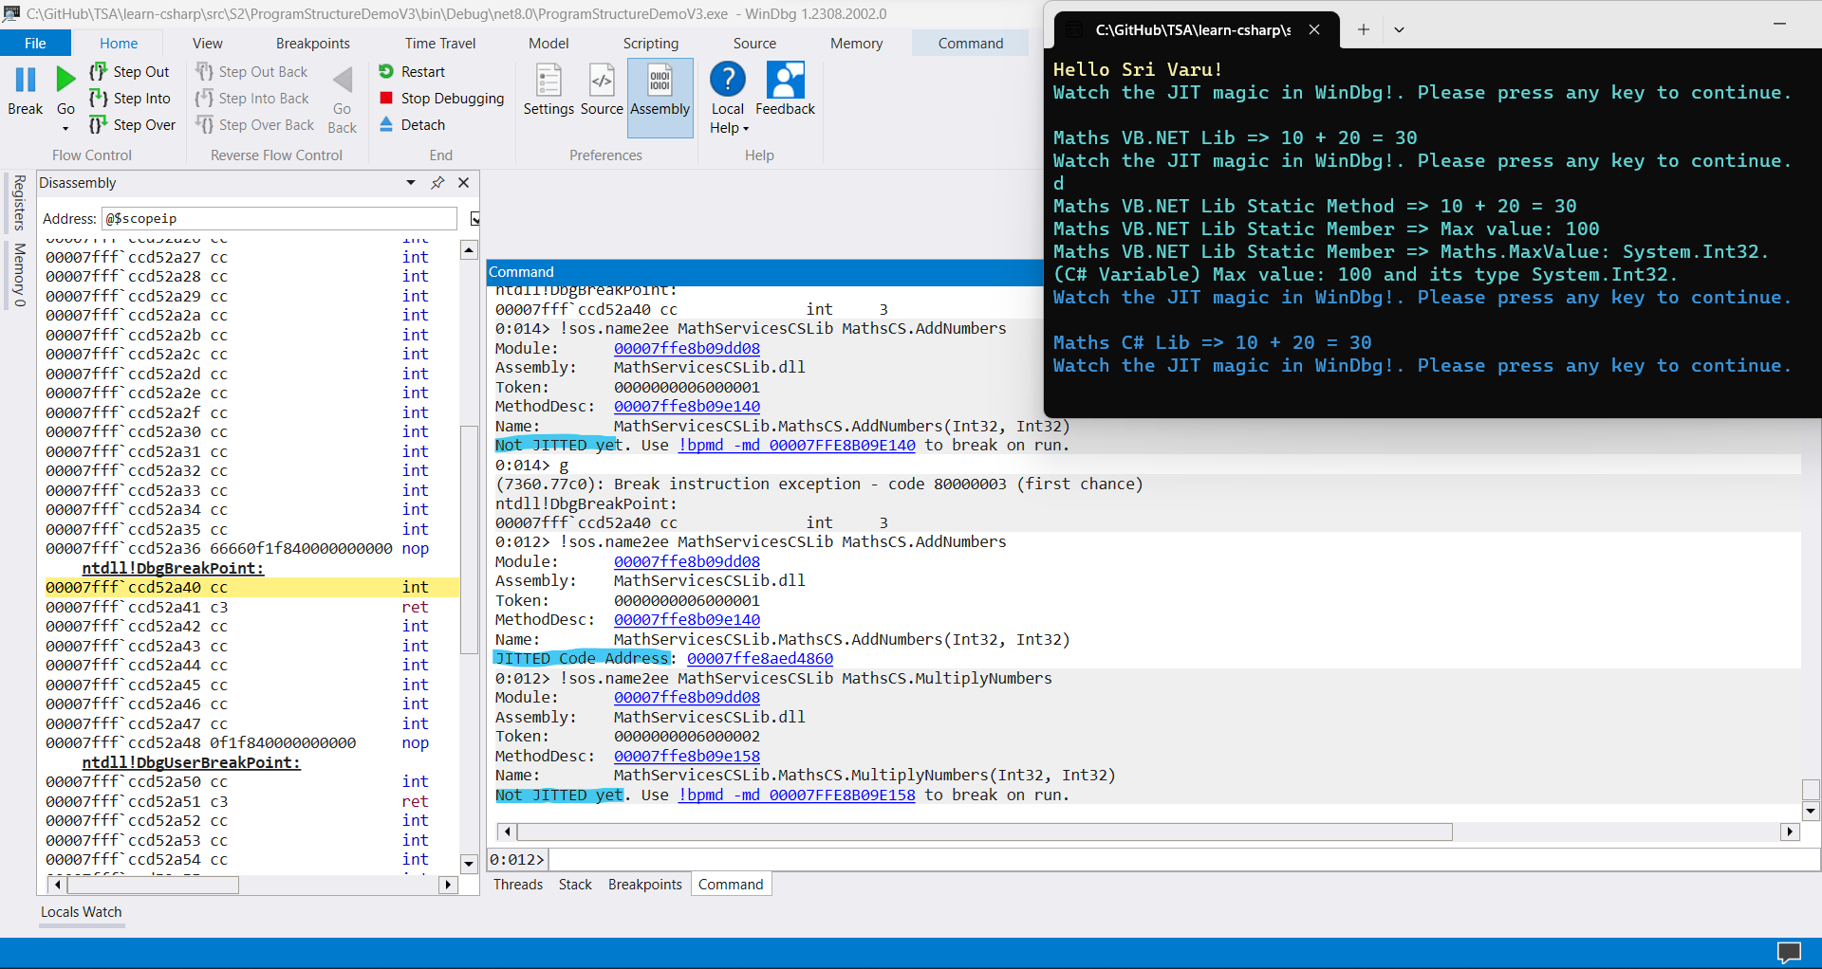

Slide 38
Dotnet Learners House
JIT Compilation .NET 6/7/8 Apps Basic Types and Conversions
Mon, Oct 09, 2023
09:00 AM (IST)
JIT Compilation .NET 6/7/8 Apps Basic Types and Conversions
Viswanatha Swamy
Architect - AIS
Event URL: https://bit.ly/3ttt2iN

Slide 39
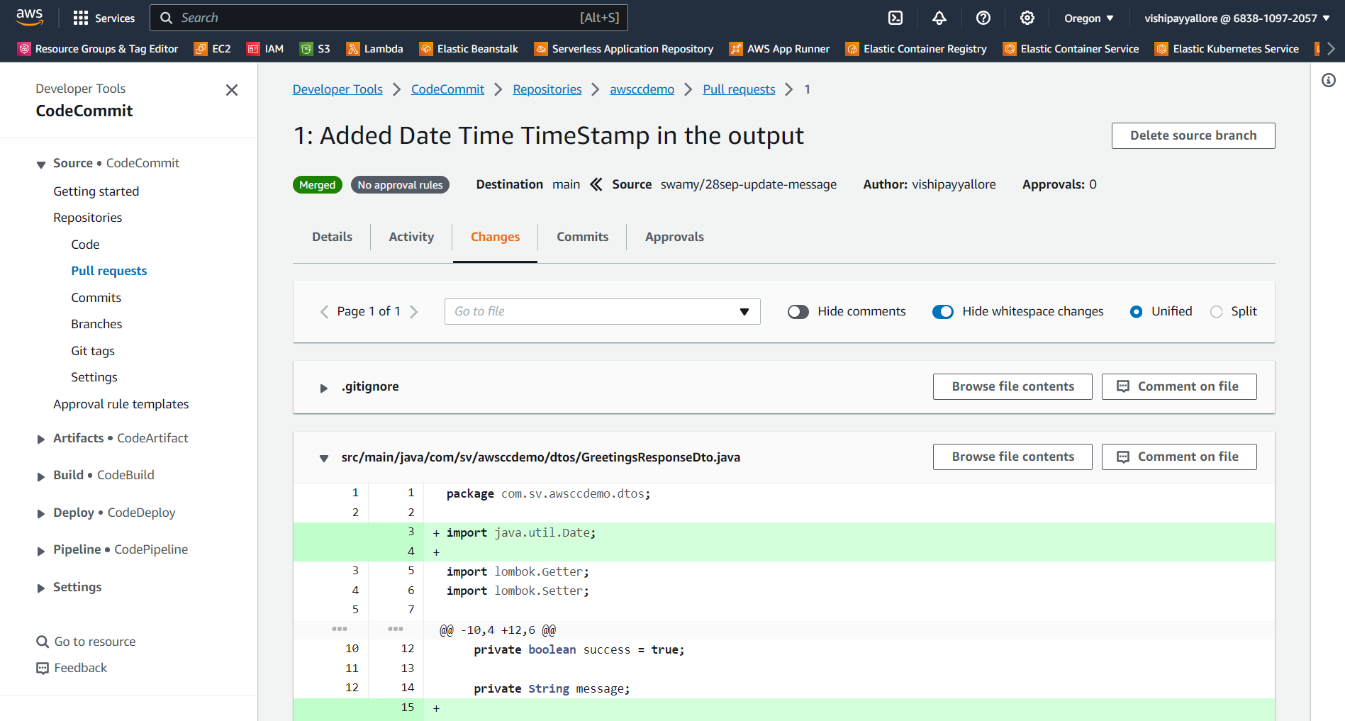

Slide 40
Dotnet Learners House
Hands-on with AWS - Code Commit - .NET 8 / Java Spring Boot
Sat, Sep 30, 2023
09:00 AM (IST)
Hands-on with AWS - Code Commit - .NET 8 / Java Spring Boot
Viswanatha Swamy
Architect - AIS
Event URL: https://bit.ly/46aXnkL

Slide 41
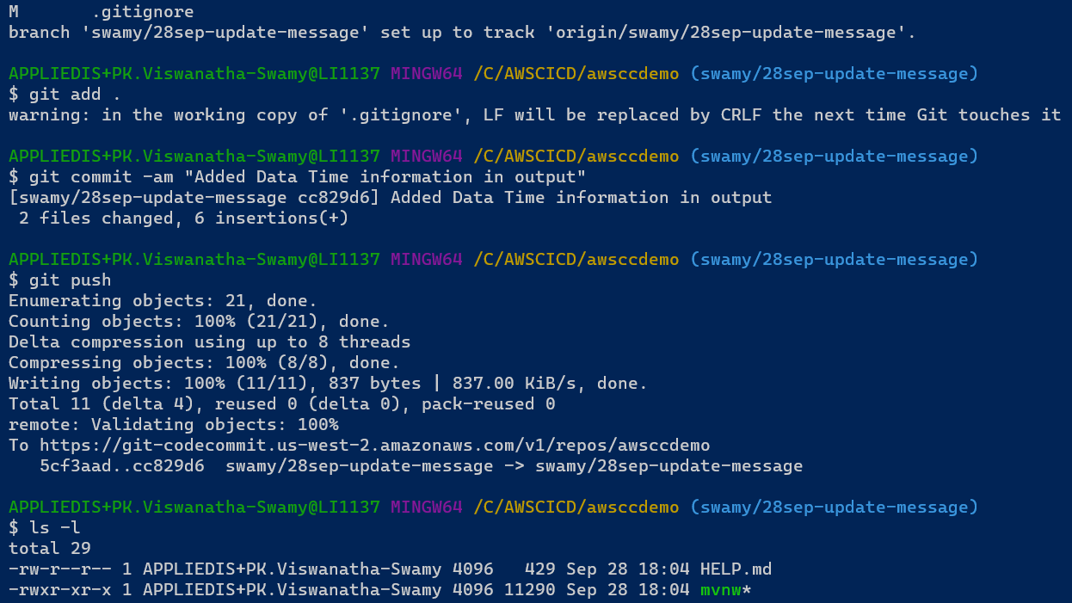

Slide 42
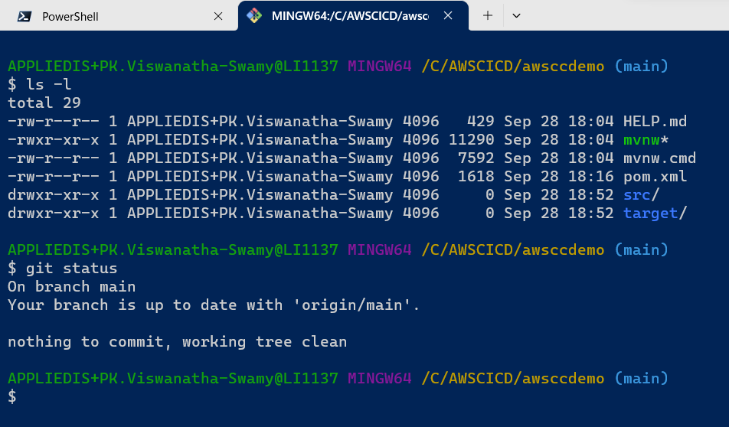

Slide 43
Dotnet Learners House
Interoperability, JIT Compilation, Debugging in VS Code
Mon, Aug 28, 2023
09:00 AM (IST)
Interoperability, JIT Compilation, Debugging in VS Code - 3 / 120
Viswanatha Swamy
Architect - AIS
Event URL: https://bit.ly/3P4TMgU

Slide 44
Source
Compiler
IL
JIT
0101

Slide 45
Front End
Middle Tier
Backend
Core
SQL
Blazor WASM
Angular
ReactJS
Vue.js
APP
API
/
gRPC
BLL
DAL
DMZ

Slide 46
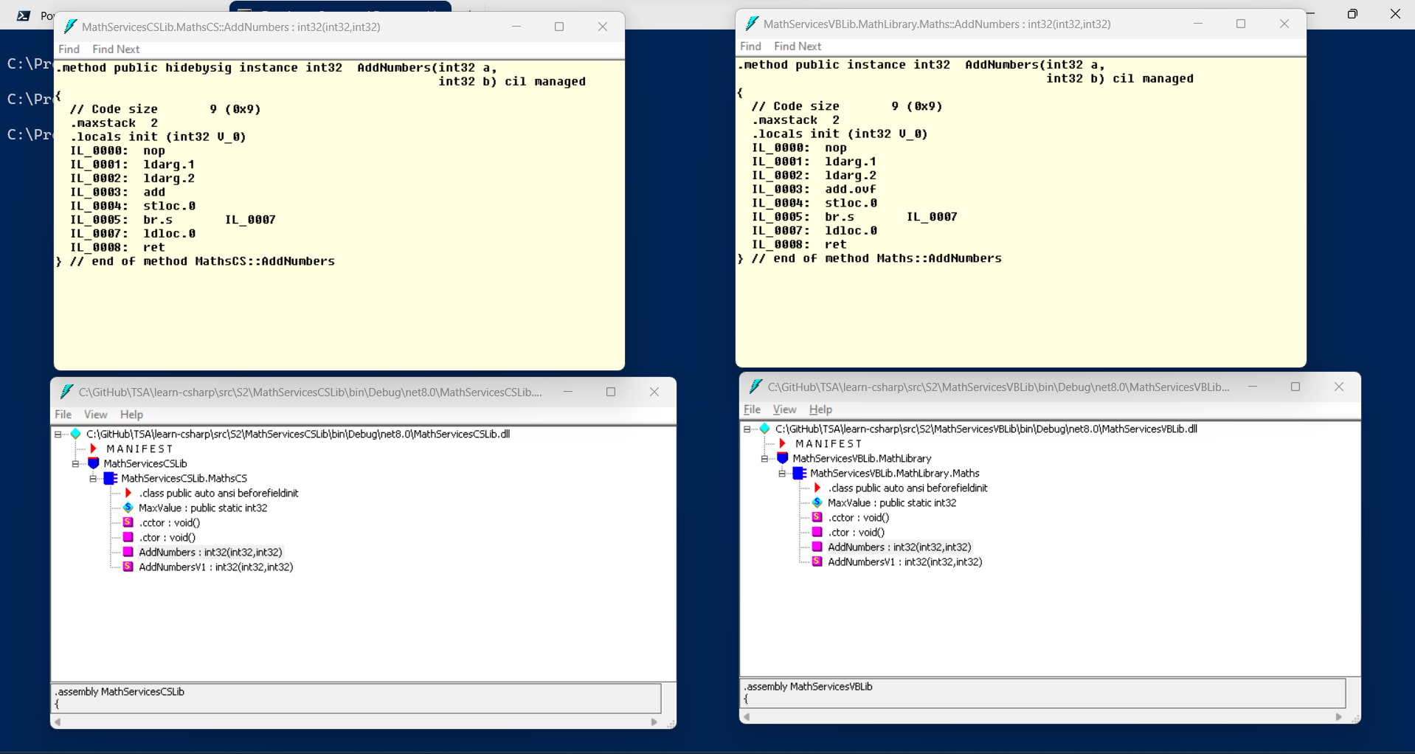

Slide 47
Dotnet Learners House
Interoperability, JIT Compilation, Debugging in VS Code
Mon, Aug 28, 2023
09:00 AM (IST)
Interoperability, JIT Compilation, Debugging in VS Code - 3 / 120
Viswanatha Swamy
Architect - AIS
Event URL: https://bit.ly/3P4TMgU

Slide 48
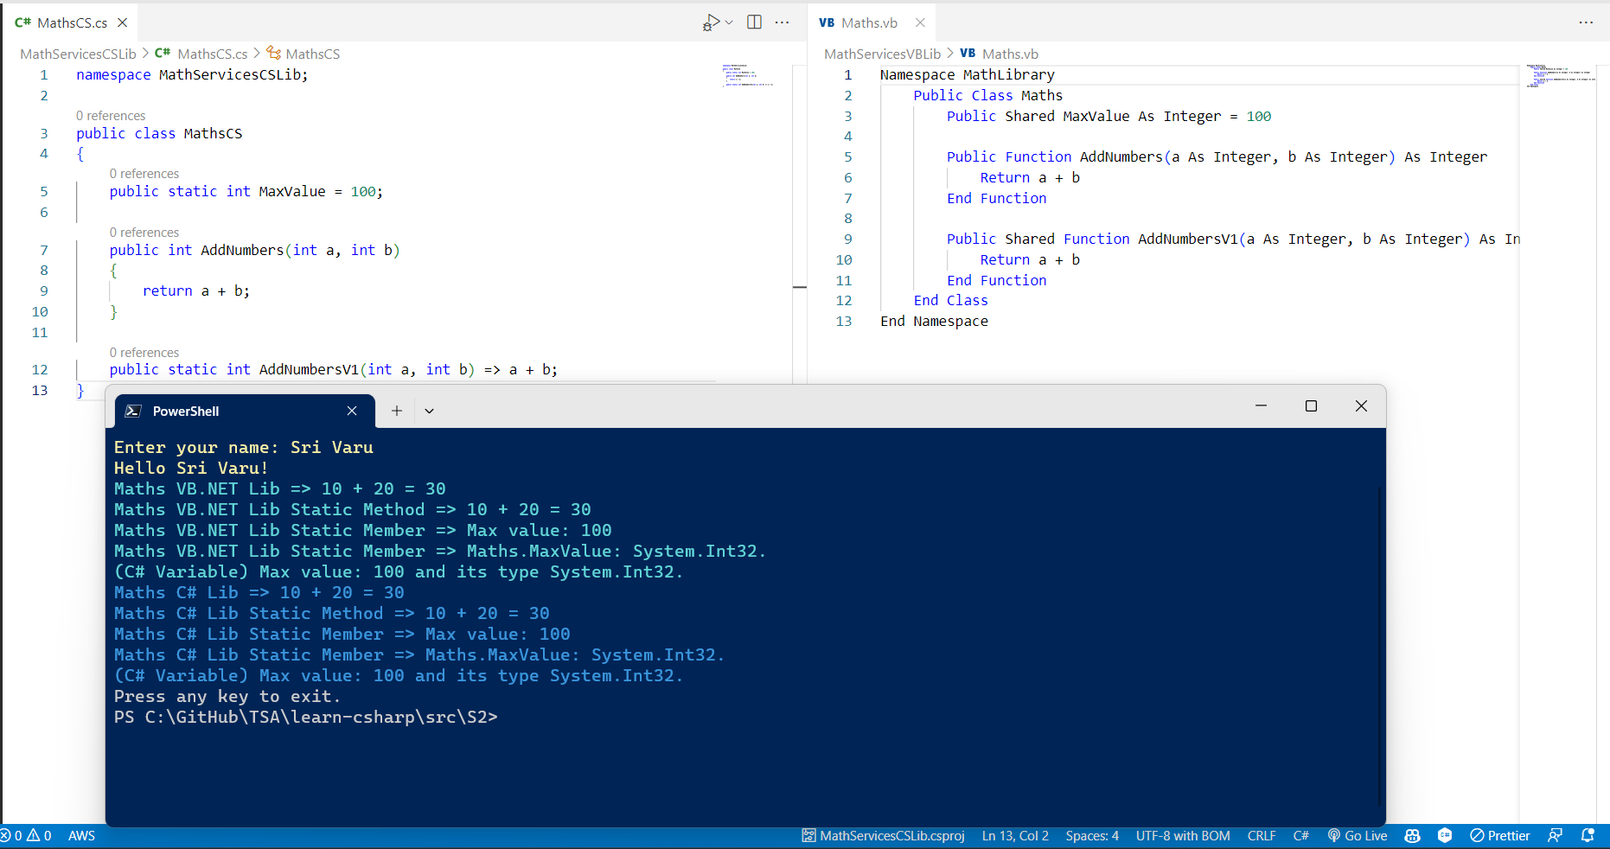

Slide 49
Dotnet Learners House
CTS, IL, JIT Compilation C# in .NET 8 - Microservices 2 / 120
Mon, Aug 28, 2023
09:00 AM (IST)
CTS, IL, JIT Compilation C# in .NET 8 - Microservices 2 / 120
Viswanatha Swamy
Architect - AIS
Event URL: https://bit.ly/3QWdY7i

Slide 50
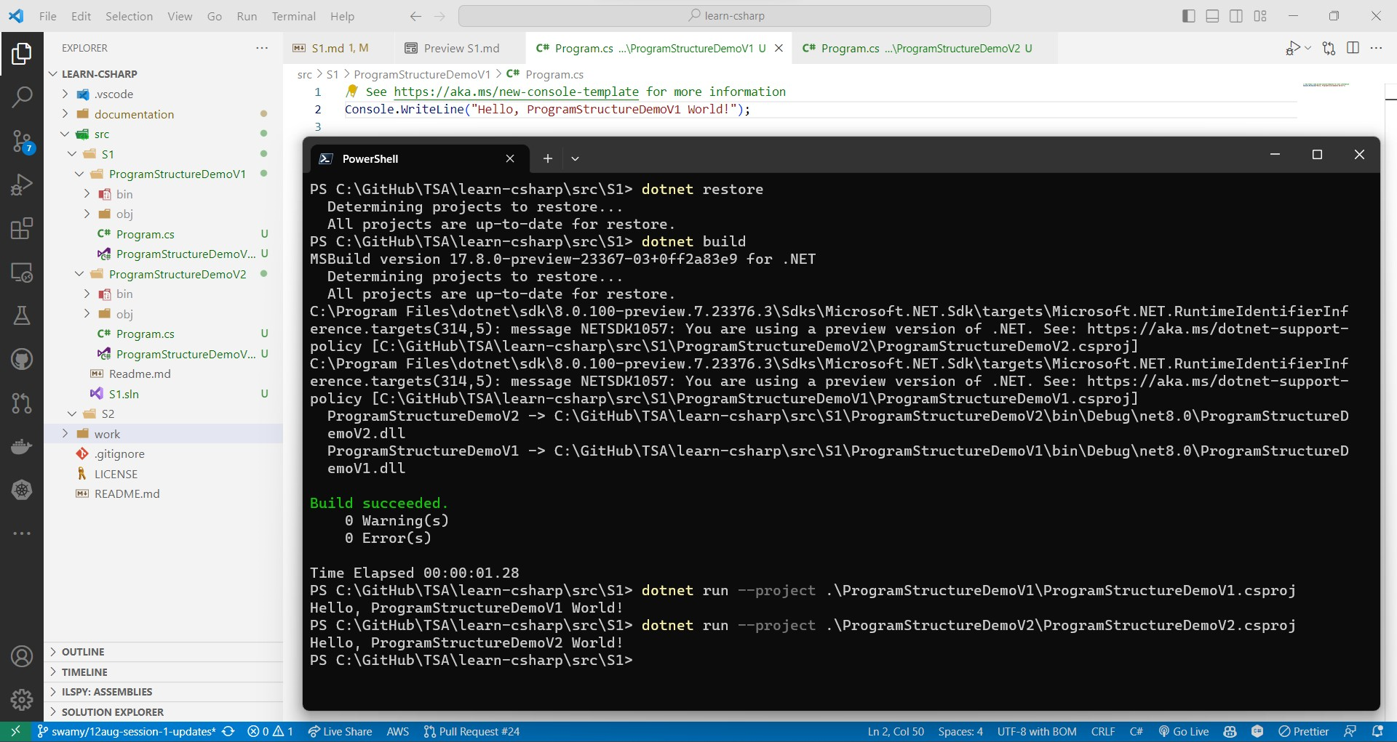

Slide 51
Dotnet Learners House
Getting started with C# in .NET 8 - Microservices Series 1 / 120
Mon, Aug 14, 2023
09:00 AM (IST)
Getting started with C# in .NET 8 - Microservices Series 1 / 120
Viswanatha Swamy
Architect - AIS
Event URL: https://bit.ly/3YAdC7S

Slide 52
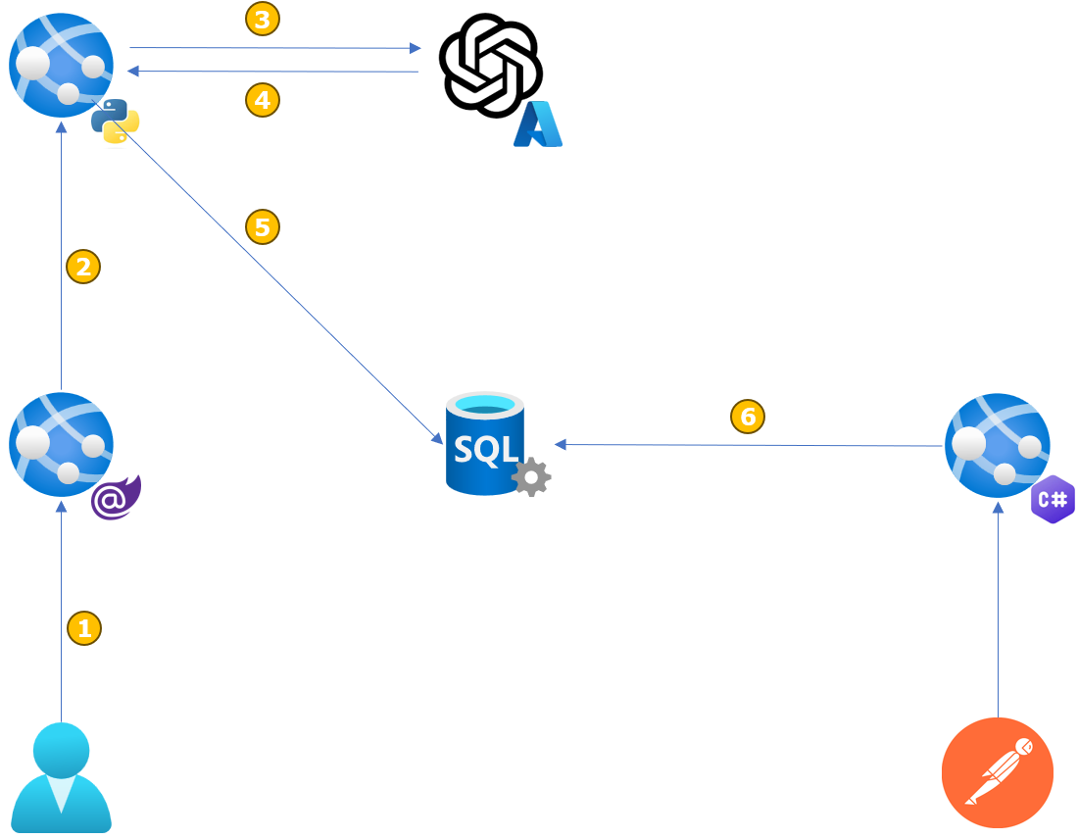

Slide 53

3
4
5
2
6
1

Slide 54
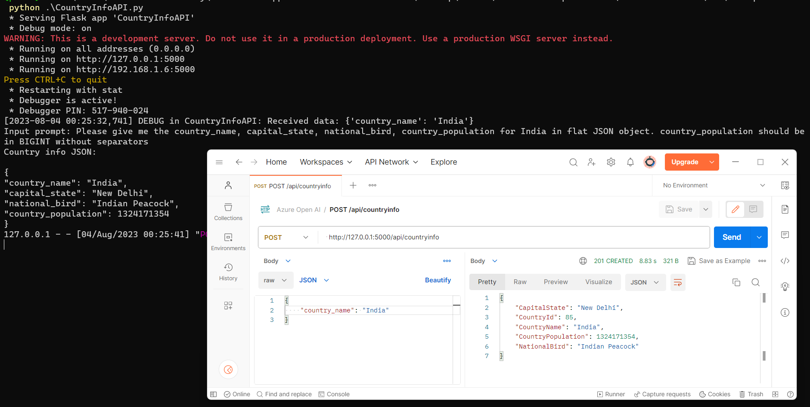

Slide 55
Dotnet Learners House
Azure OpenAI – Mini Project - Python/C#/Angular
Wed, Aug 07, 2023
09:00 AM (IST)
Azure OpenAI – Mini Project - Python/C#/Angular
Viswanatha Swamy
Architect - AIS
Event URL: https://bit.ly/3D1iGsd

Slide 56
Dotnet Learners House
Hands on with Amazon SageMaker Studio AutoML
Wed, Jul 31, 2023
09:00 AM (IST)
Hands on with Amazon SageMaker Studio AutoML
Viswanatha Swamy
Architect - AIS
Event URL: https://bit.ly/3Ozi2si

Slide 57
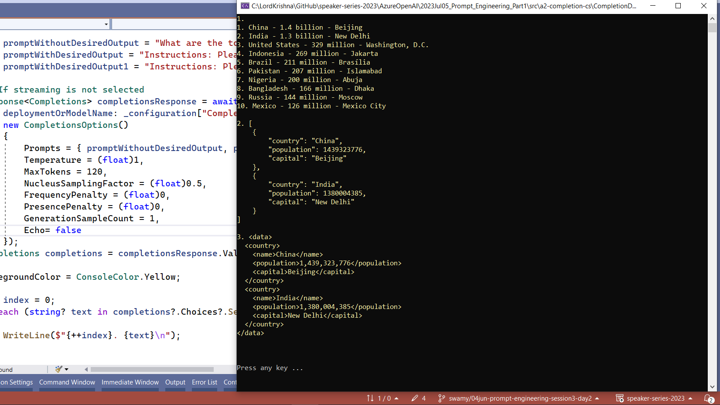

Slide 58
Dotnet Learners House
Azure OpenAI - Prompt Engineering - Studio/Postman/Python/C#
Wed, Jun 05, 2023
09:00 AM (IST)
Azure OpenAI - Prompt Engineering - Studio/Postman/Python/C#
Viswanatha Swamy
Architect - AIS
Event URL: https://bit.ly/3D1iGsd

Slide 59
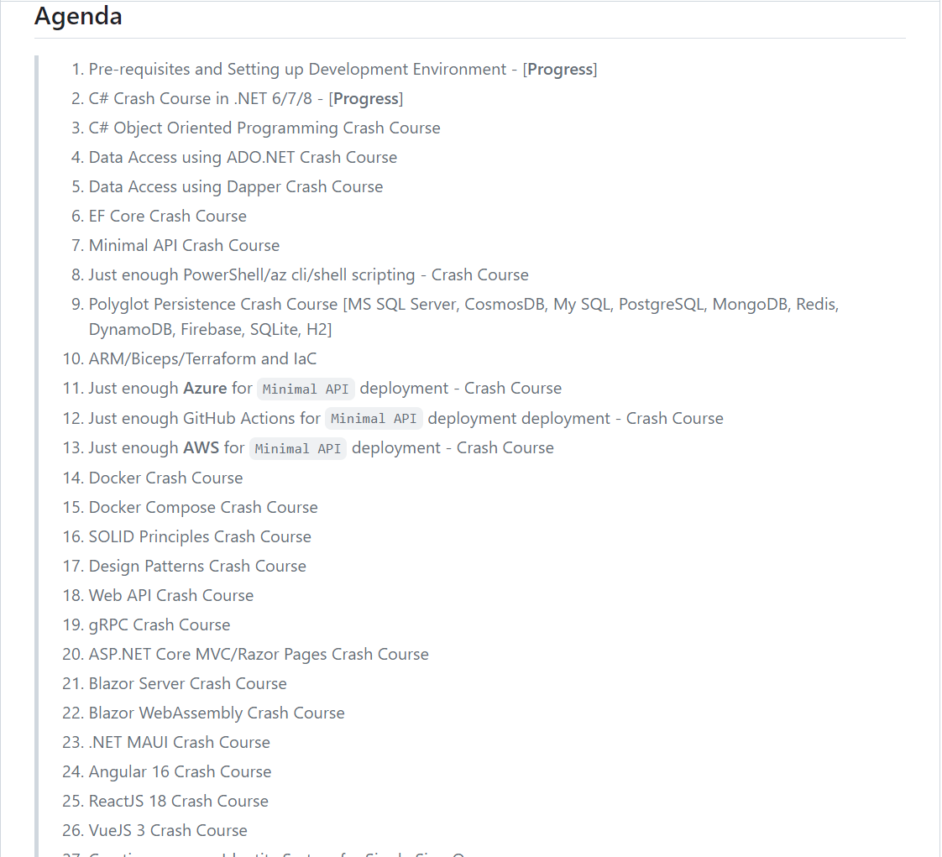

Slide 60
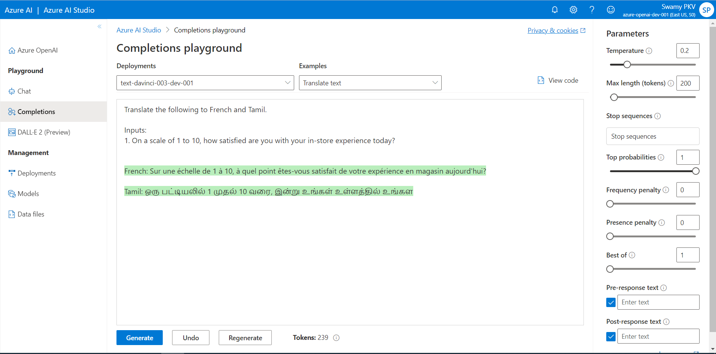
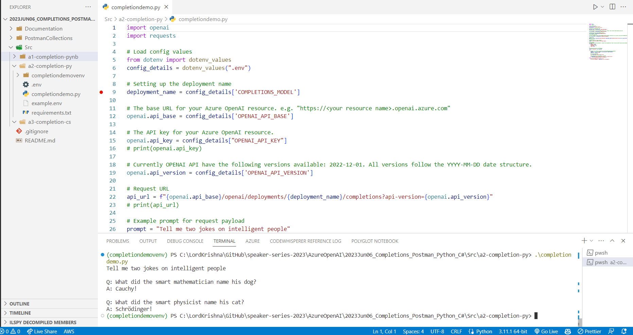

Slide 61
Dotnet Learners House
Azure OpenAI - Completion using Postman/Python/C# .NET 7
Wed, Jun 07, 2023
09:00 AM (IST)
Azure OpenAI - Completion using Postman/Python/C# .NET 7
Viswanatha Swamy
Architect - AIS
Event URL: https://bit.ly/42kUT0w

Slide 62
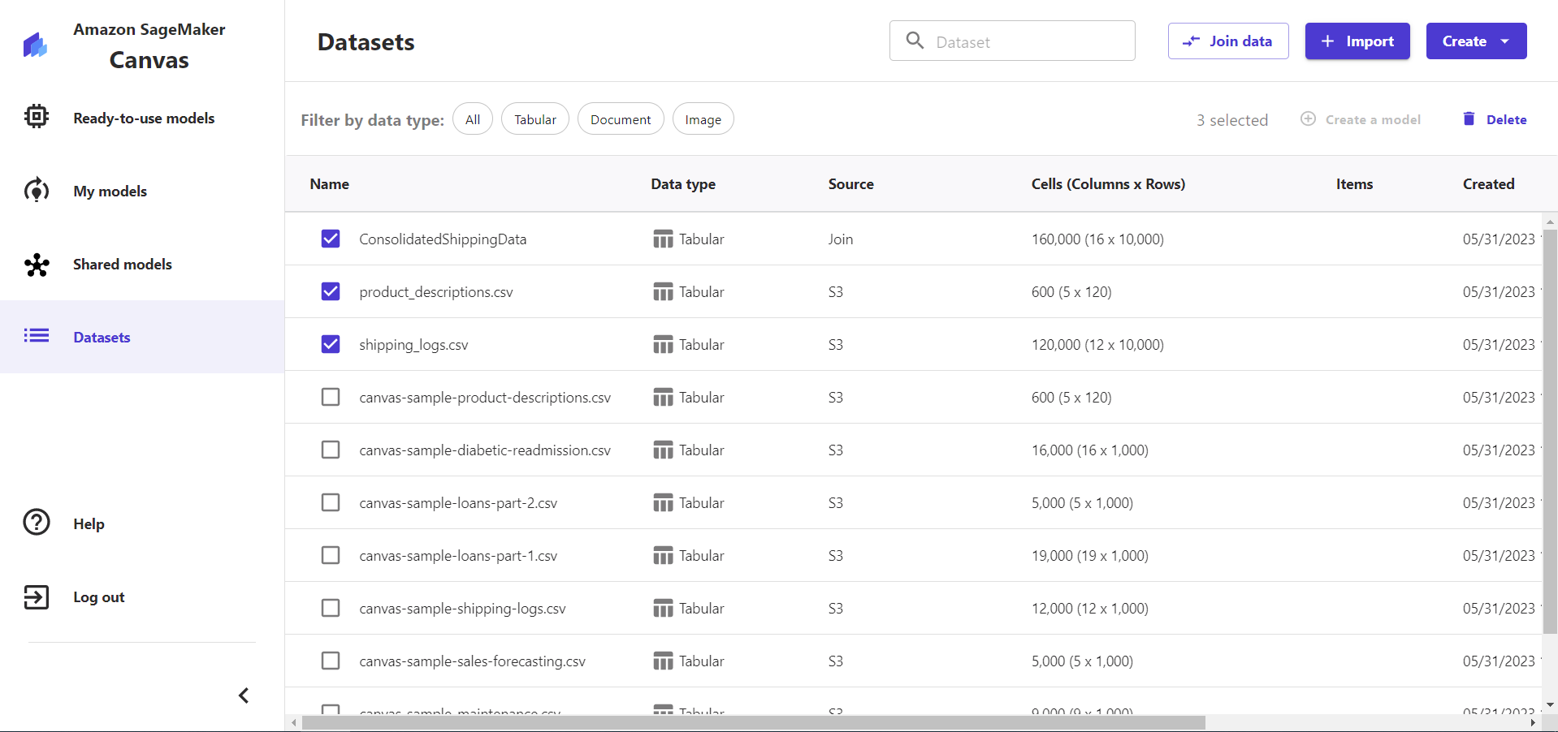

Slide 63
Dotnet Learners House
Hands-On - Getting Started with Amazon SageMaker Canvas
Wed, May 31, 2023
09:00 AM (IST)
Hands-On - Getting Started with Amazon SageMaker Canvas
Viswanatha Swamy
Architect - AIS
Event URL: https://bit.ly/43vB5Zs

Slide 65
Dotnet Learners House
Hands-On - Getting Started with Azure OpenAI
Sat, May 20, 2023
09:00 AM (IST)
Hands-On - Getting Started with Azure OpenAI
Viswanatha Swamy
Architect - AIS
Event URL: https://bit.ly/42QFKoV

Slide 66
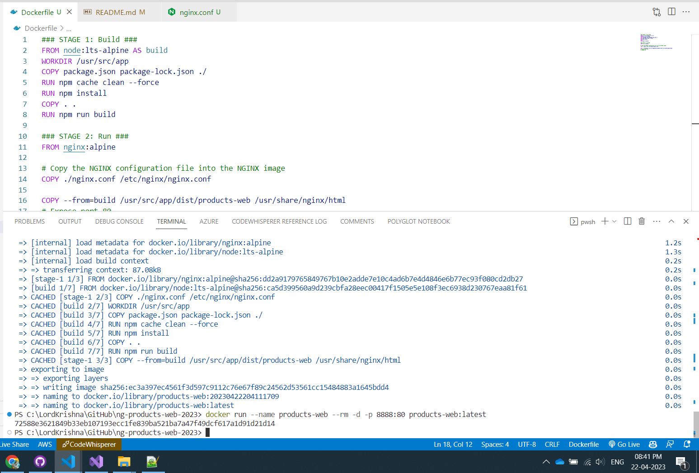

Slide 67
Dotnet Learners House
.NET 7 on AWS - Containerize .NET 7 and Angular 15 App
Sun, Aar 23, 2023
09:00 AM (IST)
.NET 7 on AWS - Containerize .NET 7 and Angular 15 App
Viswanatha Swamy
Architect - AIS
Event URL: https://bit.ly/3H639K8

Slide 68
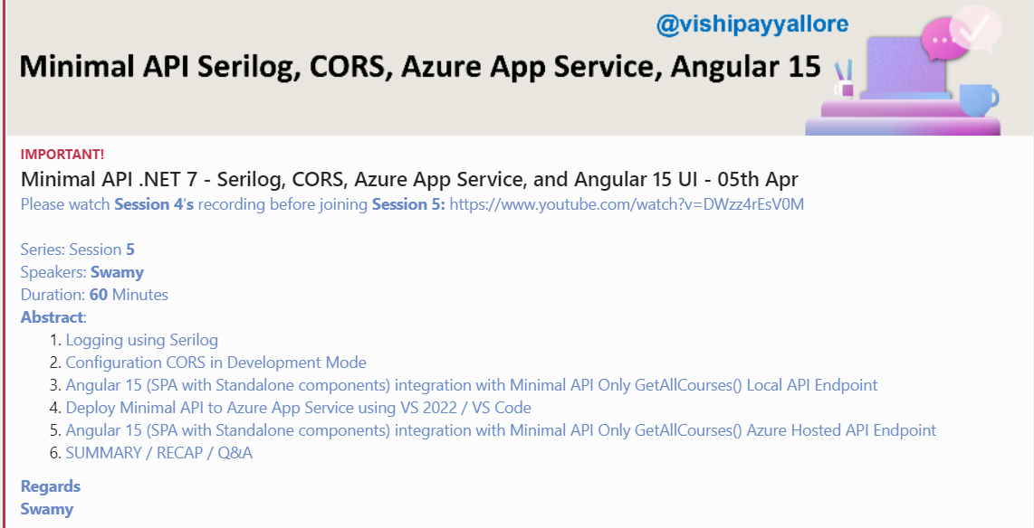

Slide 69
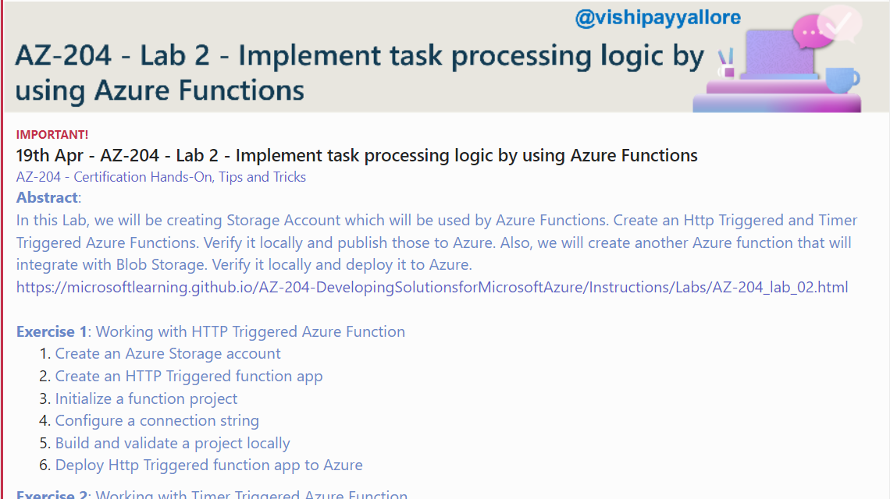

Slide 70
Dotnet Learners House
.NET 7 on AWS - MS SQL Server 2022 on AWS ECS using Fargate
Wed, Mar 29, 2023
09:00 AM (IST)
.NET 7 on AWS - MS SQL Server 2022 on AWS ECS using Fargate
Viswanatha Swamy
Architect - AIS
Event URL: http://bit.ly/3ZtFE3U

Slide 71
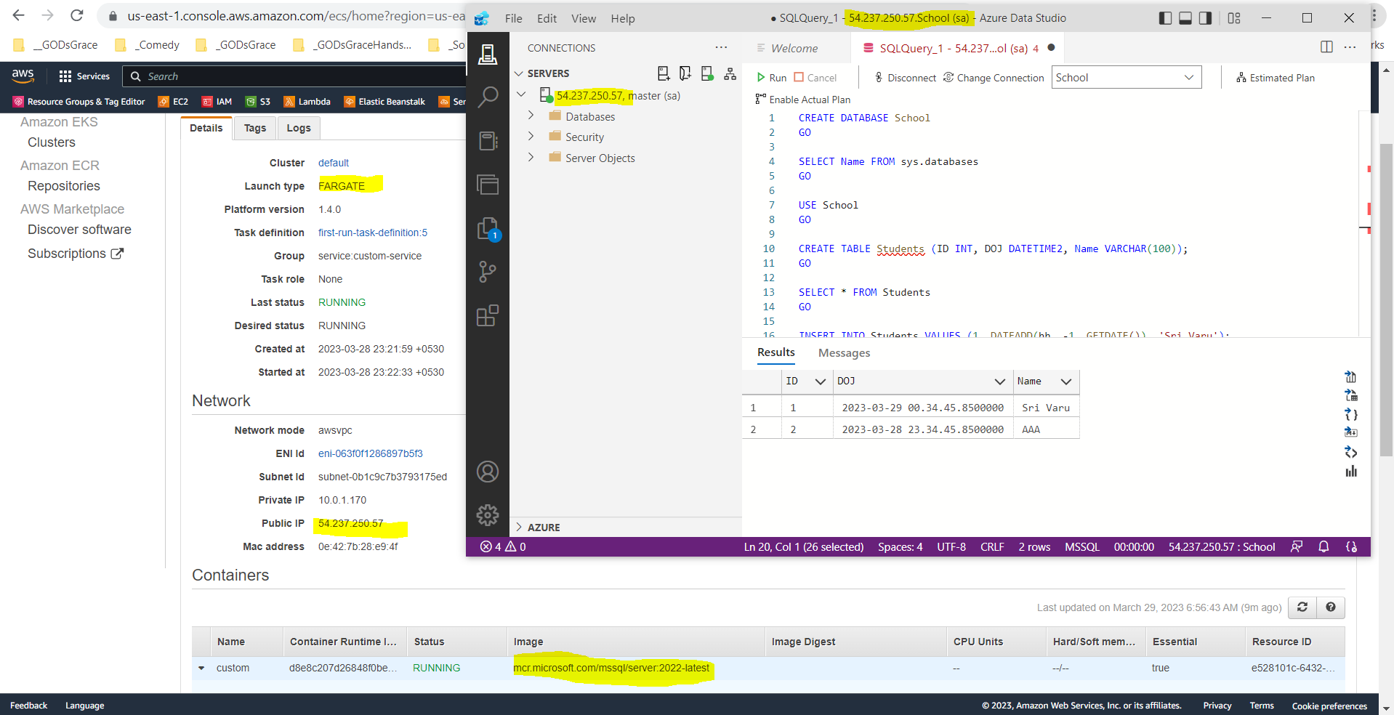

Slide 72
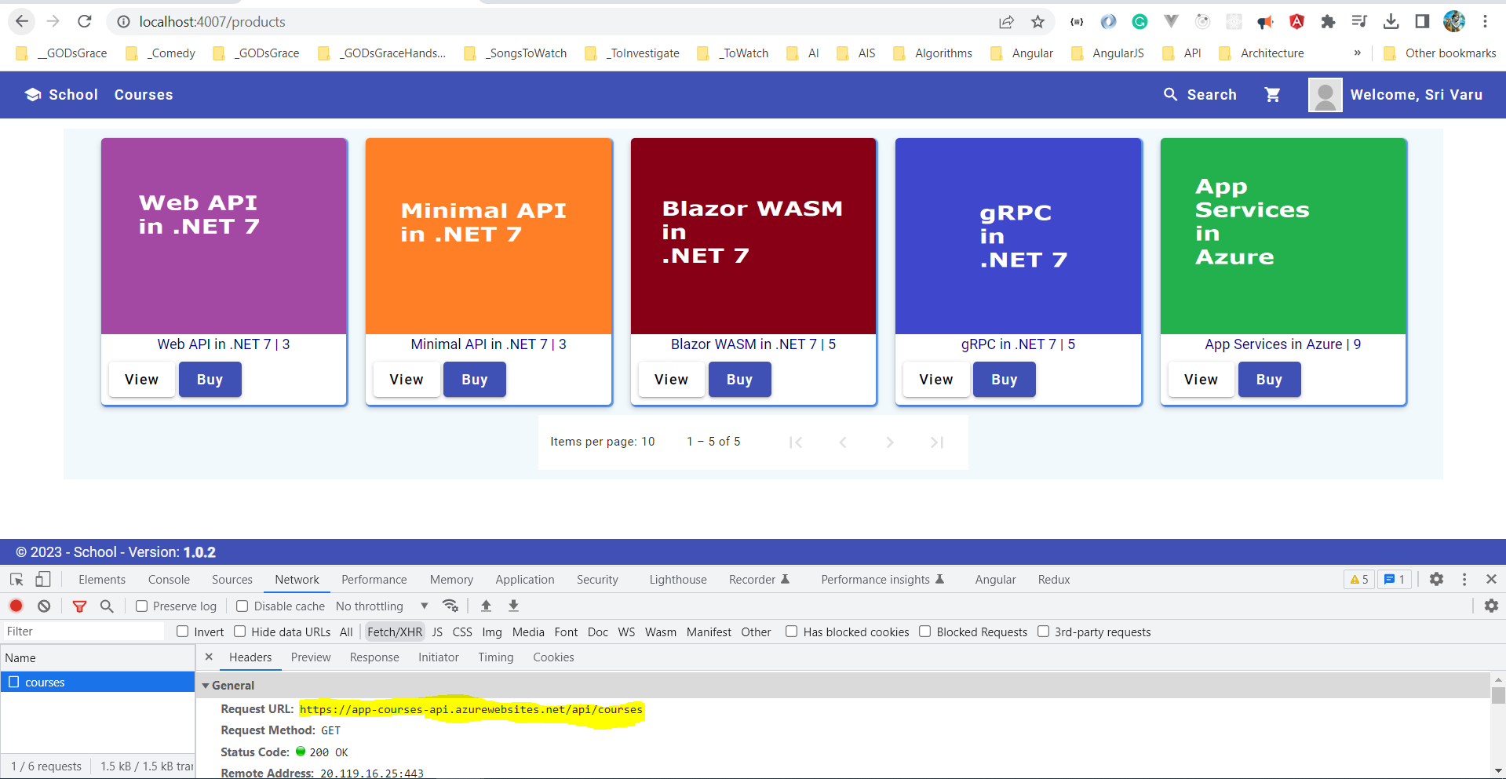

Slide 73
Dotnet Learners House
Minimal API Swagger, Repository, Business, and GitHub Actions
Sunday, Mar 12, 2023
09:00 AM (IST)
Minimal API Swagger, Repository, Business, and GitHub Actions
Viswanatha Swamy
Architect - AIS
Event URL: http://bit.ly/3KHHb2z

Slide 74
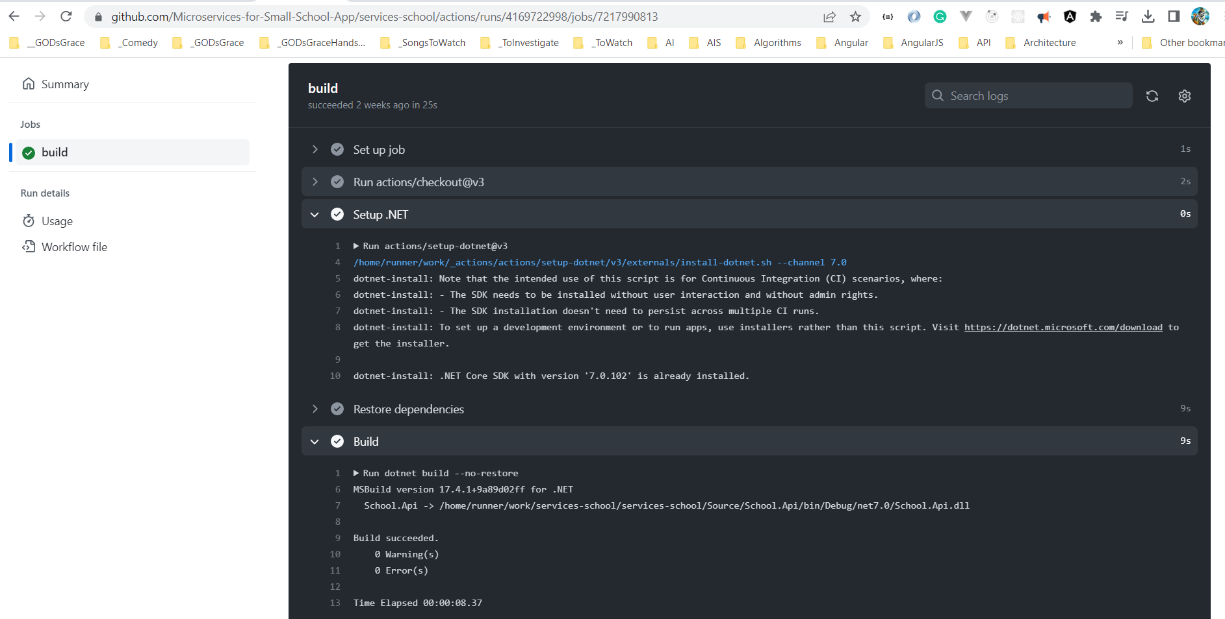

Slide 75
Dotnet Learners House
.NET 7 Minimal API DI, IOC, record, DTOs, Auto Mapper
Sunday, Feb 19, 2023
09:00 AM (IST)
.NET 7 Minimal API DI, IOC, record, DTOs, Auto Mapper
Viswanatha Swamy
Architect - AIS
Event URL: https://bit.ly/40udZl6

Slide 76
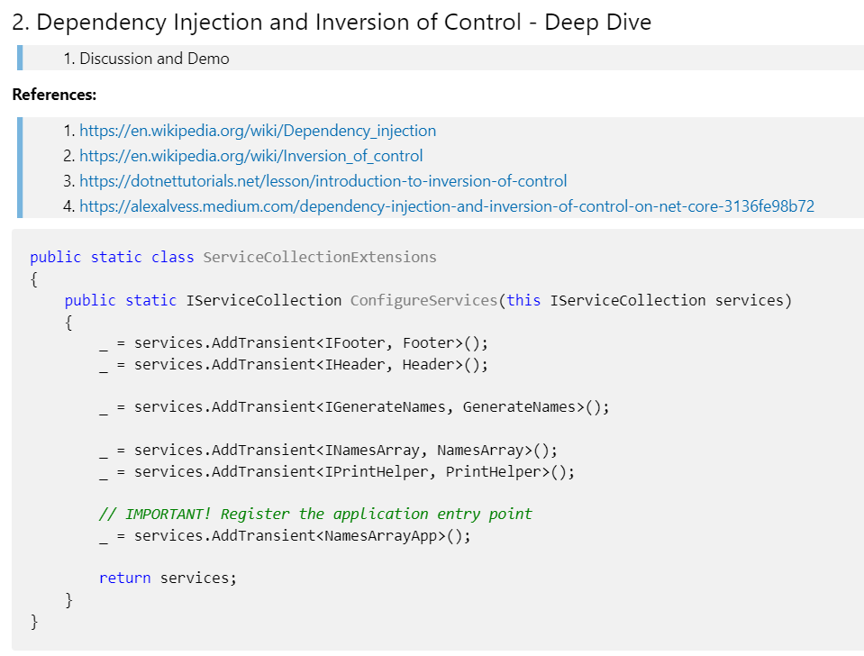

Slide 77
Dotnet Learners House
.NET 6 AWS Creating Docker Images, Deploying to ECS / Fargate
Sunday, Feb 12, 2023
09:00 AM (IST)
.NET 6 AWS Docker Images, Deploying to ECS Fargate
Viswanatha Swamy
Architect - AIS
Event URL: http://bit.ly/3K0gUMM

Slide 78
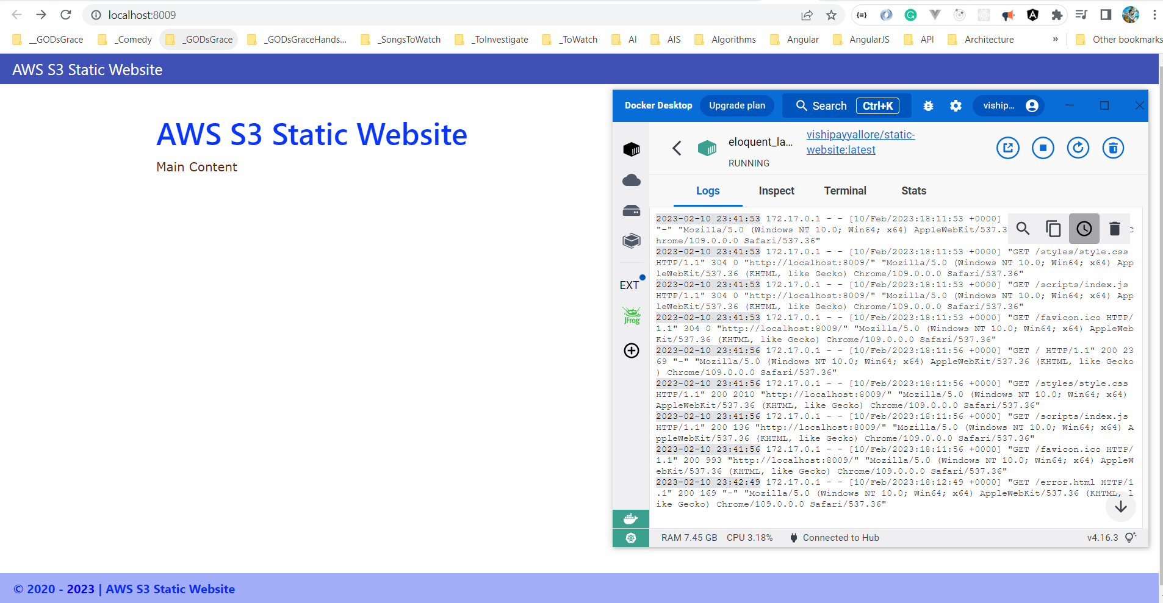

Slide 79
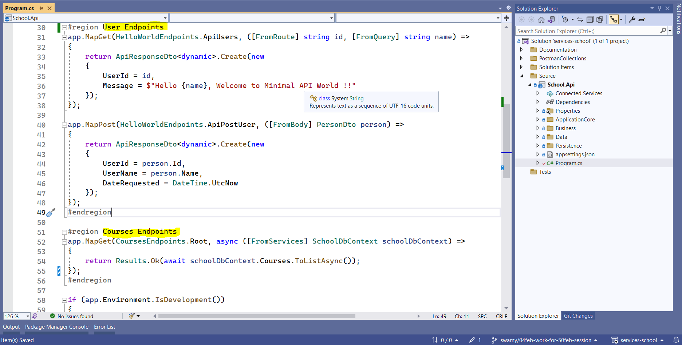

Slide 80
Dotnet Learners House
C# (.NET 6) on AWS - Getting Started With Fargate and ECS
Sunday, Jan 29, 2023
09:00 AM (IST)
C# .NET 6 AWS - Getting Started With Fargate and ECS
Viswanatha Swamy
Associate Architect - AIS
Event URL: http://bit.ly/3XJ7IQB

Slide 81
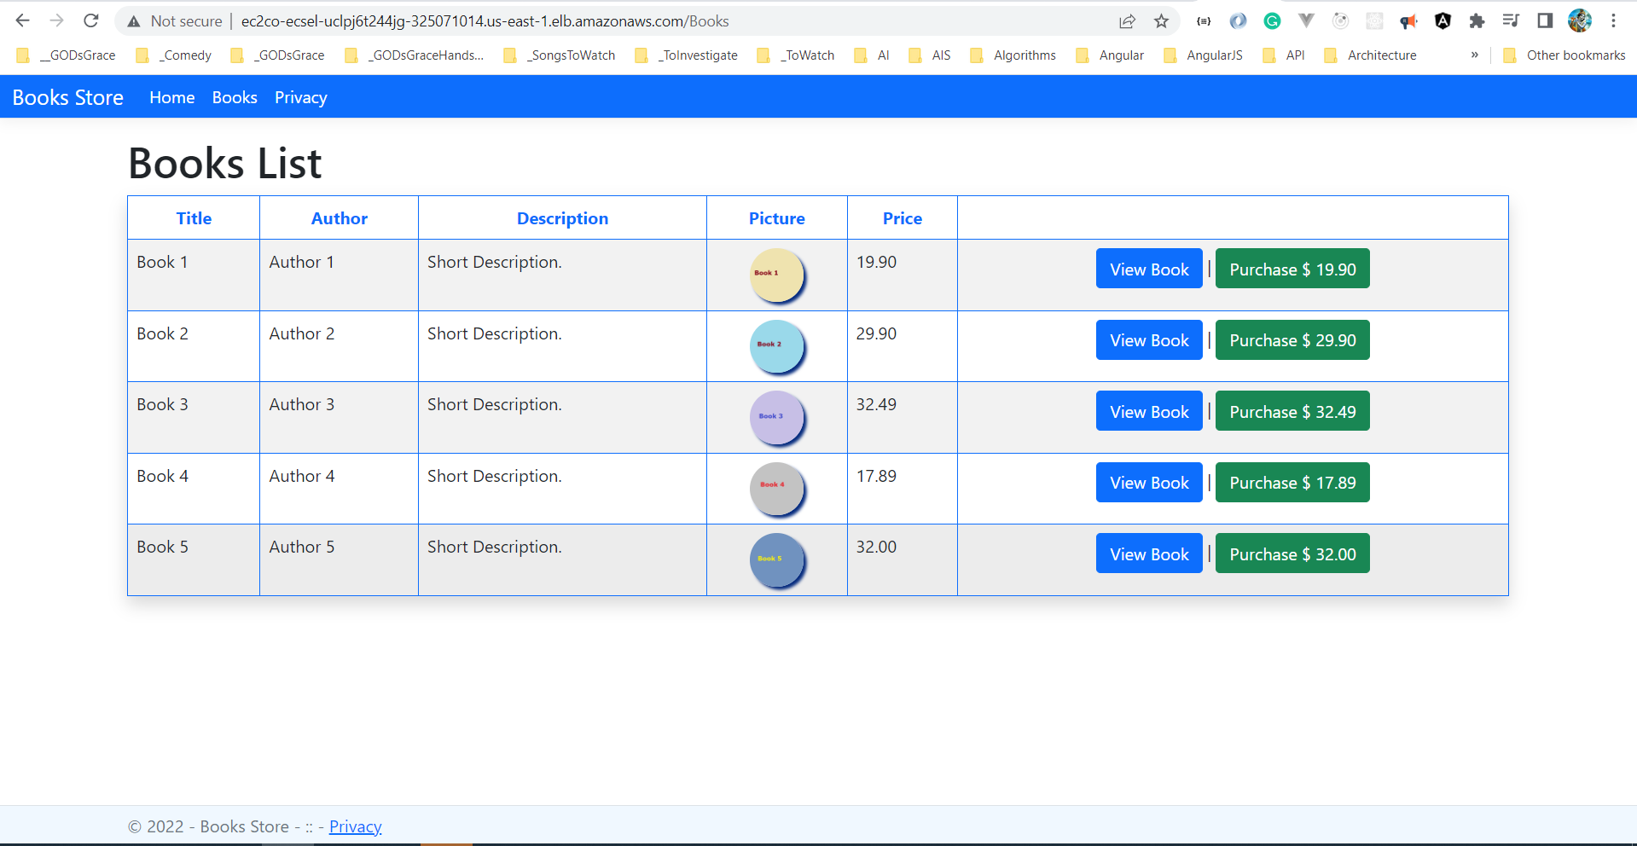

Slide 82
Dotnet Learners House
.NET 7 - Hands on Minimal API with ASP.NET Core, and Static data
Friday, Jan 20, 2023
06:30 AM (IST)
.NET 7 – Hands-on Minimal API with ASP.NET Core
Viswanatha Swamy
Associate Architect - AIS
Event URL: http://bit.ly/3VMeKlX

Slide 83
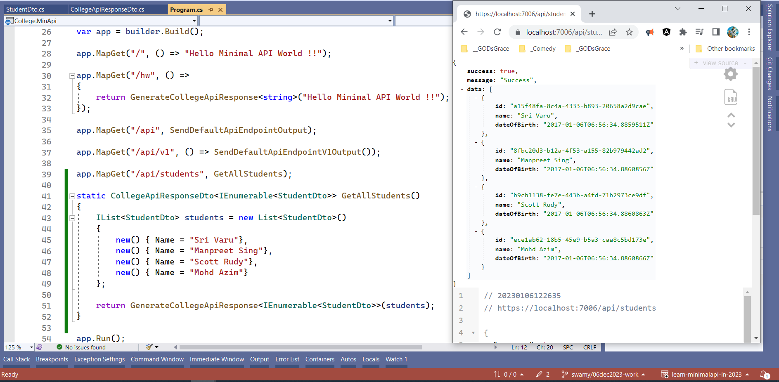

Slide 84
Dotnet Learners House
Lambda Integration S3, SQS, SNS using .NET 6 and C#
Sunday, Dec 25, 2022
10:00 AM (IST)
Lambda Integration S3, SQS, SNS in C# (.NET 6)
Viswanatha Swamy
Associate Architect - AIS
Event URL: https://bit.ly/3WnFNoS

Slide 85
Information
I am still a learner. Apologize if I do any mistake.
All the sessions will be hands on.
Will have parking lots for queries and other topics.
Some of the concepts we will introduced and revisited in next sessions.
There are multiple ways to do, we will use one of the ways.
The focus was more on concepts and demos are kept simple.
C# Corner

Slide 86
Information
I am still a learner. Apologize if I do any mistake.
All the sessions will be hands on.
Will have parking lots for queries and other topics.
Some of the concepts we will introduced and revisited in next sessions.
There are multiple ways to do, we will use one of the ways.
The focus was more on concepts and demos are kept simple.
Pune Tech Community

Slide 87
Front End
Middle Tier
Backend
Core
SQL
Blazor WASM
Angular
ReactJS
Vue.js
APP
API
/
gRPC
BLL
DAL
DMZ

Slide 88




Azure Key Vault
4
1
2
3
5
User
Blazor WASM
Web API
Azure SQL Server
August 2021 Version

Slide 89


Basket API
+
Data Store
API
Gateway
Discount API
+
Data Store
Orders API
+
Data Store
Identity API
+
Data Store

Slide 90
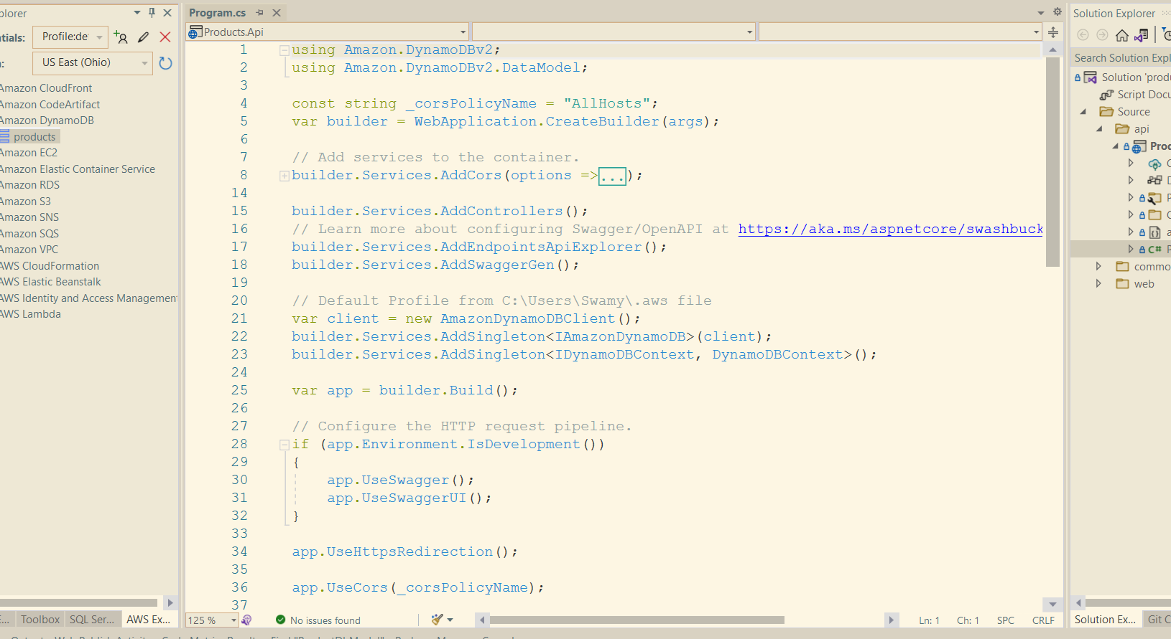
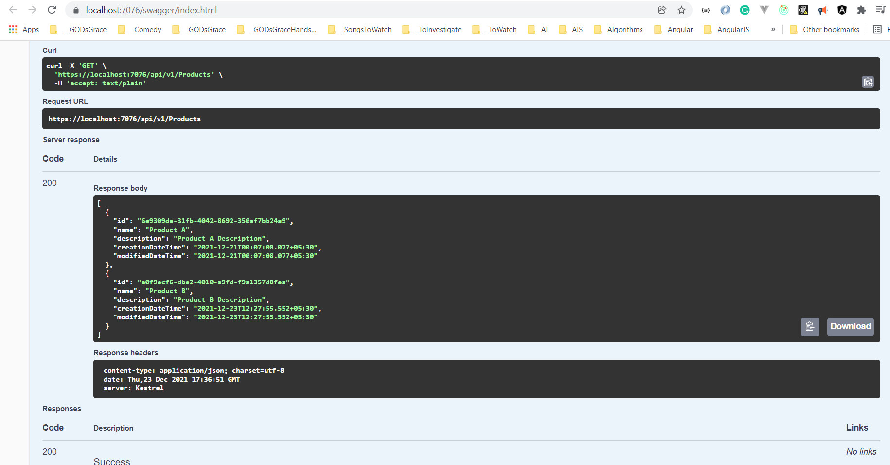



Slide 91
Information
I am still a learner. Apologize if I do any mistake.
All the sessions will be hands on.
Will have parking lots for queries and other topics.
Some of the concepts we will introduced and revisited in next sessions.
There are multiple ways to do, we will use one of the ways.
The focus was more on concepts and demos are kept simple.
Dot Net Learners House

Slide 92




Slide 93






9
Azure Key Vault
6
Azure Redis Cache
8
Blazor WASM
1
2
JWT
4
5
API Mgmt
Web API
7
3
Azure SQL Server
Auth0
High Lights:
Blazor WASM UI get authenticated and pass the JWT to APIM.
APIM Validates the JWT and routes the request to Web API.
SQL Server, and Redis Cache’s credentials are stored in Azure Key Vault.
Web API investigates Azure Redis Cache before hitting SQL Azure. (Cache Aside Pattern)
We will preform Dacpac (.sqlproj) for deployment of SQL Data Store.

Slide 94
9
Azure Key Vault
6
Azure Redis Cache
8
Blazor WASM
1
2
JWT
4
5
API Mgmt
Web API
7
3
Azure SQL Server
Auth0
High Lights:
Blazor WASM UI get authenticated and pass the JWT to APIM.
APIM Validates the JWT and routes the request to Web API.
SQL Server, and Redis Cache’s credentials are stored in Azure Key Vault.
Web API investigates Azure Redis Cache before hitting SQL Azure. (Cache Aside Pattern)
We will preform Dacpac (.sqlproj) for deployment of SQL Data Store.

Slide 95
Information
All the sessions will be hands on.
Will have parking lots for queries and other topics.
Some of the concepts we will introduced and revisited in next sessions.
There are multiple ways to do, we will use one of the ways.
The focus was more on concepts and demos are kept simple.
I am still a learner. What!!! … wait … Yes, I am still a learner.
Microsoft Reactor Bengaluru

Slide 96
Information
I am still a learner. What!!! … Yes, I am still a learner. Apologize if I do any mistake.
All the sessions will be hands on.
Will have parking lots for queries and other topics.
Some of the concepts we will introduced and revisited in next sessions.
There are multiple ways to do, we will use one of the ways.
The focus was more on concepts and demos are kept simple.
Power Platform Classmates

Slide 97
Information
All the sessions will be hands on.
Will have parking lots for queries and other topics.
Some of the concepts we will introduced and revisited in next sessions.
There are multiple ways to do, we will use one of the ways.
The focus was more on concepts and demos are kept simple.
I am still a learner. What!!! … wait … Yes, I am still a learner.
Global Azure 2021 - India

Slide 98
Information
I am still a learner. Apologize if I do any mistake.
All the sessions will be hands on.
Will have parking lots for queries and other topics.
Some of the concepts we will introduced and revisited in next sessions.
There are multiple ways to do, we will use one of the ways.
The focus was more on concepts and demos are kept simple.
https://www.azconf.dev

Slide 99










This Photo by Unknown Author is licensed under CC BY-SA-NC
This Photo by Unknown Author is licensed under CC BY
This Photo by Unknown Author is licensed under CC BY
This Photo by Unknown Author is licensed under CC BY
This Photo by Unknown Author is licensed under CC BY-SA
This Photo by Unknown Author is licensed under CC BY-NC-ND

Slide 100
Information
All the sessions will be hands on.
Will have parking lots for queries and other topics.
Some of the concepts we will introduced and revisited in next sessions.
There are multiple ways to do, we will use one of the ways.
The focus was more on concepts and demos are kept simple.
I am still a learner. What!!! … wait … Yes, I am still a learner.
AIS

Slide 101
Information
All the sessions will be hands on.
Will have parking lots for queries and other topics.
Some of the concepts we will introduced and revisited in next sessions.
There are multiple ways to do, we will use one of the ways.
The focus was more on concepts and demos are kept simple.
I am still a learner. What!!! … wait … Yes, I am still a learner.
mobconf

Slide 102
Information
All the sessions will be hands on.
Will have parking lots for queries and other topics.
Some of the concepts we will introduced and revisited in next sessions.
There are multiple ways to do, we will use one of the way.
The focus was more on concepts and demos are kept simple.
I am still a learner. What!!! … wait … Yes, I am still a learner.
BDotNet

Slide 103
Information
All the sessions will be hands on.
Will have parking lots for queries and other topics.
Some of the concepts we will introduced and revisited in next sessions.
There are multiple ways to do, we will use one of the way.
The focus was more on concepts and demos are kept simple.
I am still a learner. What!!! … wait … Yes, I am still a learner.
Hyderabad Power Apps and Power Automate UG

Slide 104
Information
All the sessions will be hands on.
Will have parking lots for queries and other topics.
Some of the concepts we will introduced and revisited in next sessions.
There are multiple ways to do, we will use one of the way.
The focus was more on concepts and demos are kept simple.
I am still a learner. What!!! … wait … Yes, I am still a learner.
The Tech Platform

Slide 105
Information
All the sessions will be hands on.
Will have parking lots for queries and other topics.
Some of the concepts we will introduced and revisited in next sessions.
There are multiple ways to do, we will use one of the way.
The focus was more on concepts and demos are kept simple.
I am still a learner. What!!! … wait … Yes, I am still a learner.
Angular Hyderabad

Slide 106




Slide 107
Please fasten
your
seat belt !!!
Dot Net Learners House

Slide 108
Q & A
Dot Net Learners House

Slide 109
Thank You
Viswanatha Swamy
LinkedIn: https://www.linkedin.com/in/viswanatha-swamy-b57326128/
Twitter: https://twitter.com/vishipayyallore
Dot Net Learners House

